Slide 1
The Economics of Privacy
Alessandro Acquisti
Carnegie Mellon University
2016 Digital Information Policy Scholars Conference on Privacy
George Mason University

Slide 2
“The Economics of Privacy,” Acquisti, Taylor, and Wagman, Journal of Economic Literature, 2016

Slide 3
Agenda
A brief history of the economics of privacy
Some open issues
A few conclusions

Slide 4
Agenda
A brief history of the economics of privacy
Some open issues
A few conclusions

Slide 5
The evolution of the economics of privacy
Early 1980s
  The Chicago School
Mid 1990s
  The IT revolution
2000s and onward
  Expansion and fragmentation

Slide 6
The early days: Posner
Privacy as concealment of information
  Individuals with negative traits (e.g., low quality employees) have interest in hiding them
  Individuals with positive traits have interest in showing them
  Reducing information available to “buyers” in the market (e.g., employers) reduces efficiency
Costs of concealment borne by others
  E.g., when privacy of sex-offenders is protected
Extends argument to non-market behavior
  E.g., marriage
Bottom line: Privacy is re-distributive and reduces efficiency

Slide 7
The early days: Stigler
Exchange of information will lead to desirable economic outcomes independently of ownership of data
  E.g.: If I am a “good” debtor, I want this information to be known; if I am a “bad” debtor, I want to keep it secret
  Suppose I am a bad debtor: then, whether I hide information or information about me is reported, I will pay higher rates (no information == bad information)
Also, Stigler believes in a specific model of data ownership
  Information about a person may have been costly acquired by another entity – thus it may rightly “belong” to that entity

Slide 8
The mid 1990s: Varian
Externalities (positive and negative) arise due to the secondary use of information
Digitization of information creates novel challenges: collapsing MCs render semi-private information fully public
Proposal: define property rights in private information in ways that allow consumers to retain control over how information about them is used
  E.g., make it costly to access certain digital information

Slide 9
The mid 1990s: Noam
In absence of transaction costs in trading data, initial assignment of privacy rights is arbitrary from viewpoint of economic efficiency
  Encryption
    “The existence of encryption may largely determine who has to pay whom, not whether something will happen”
    In fact, encryption at most makes parties other than the data subject pay. Hence, it redistributes wealth to consumers

Slide 10
The mid 1990s: Laudon
“Markets and Privacy,” CACM, 1996
  (One of the) first to propose personal data markets / data warehouses

Slide 11
2000s and onwards
  “Expansion and fragmentation”
    Increased modeling sophistication
    Diversification of focus
    Emergence of empirical analyses
    Emergence of applied behavioral economic research

Slide 12
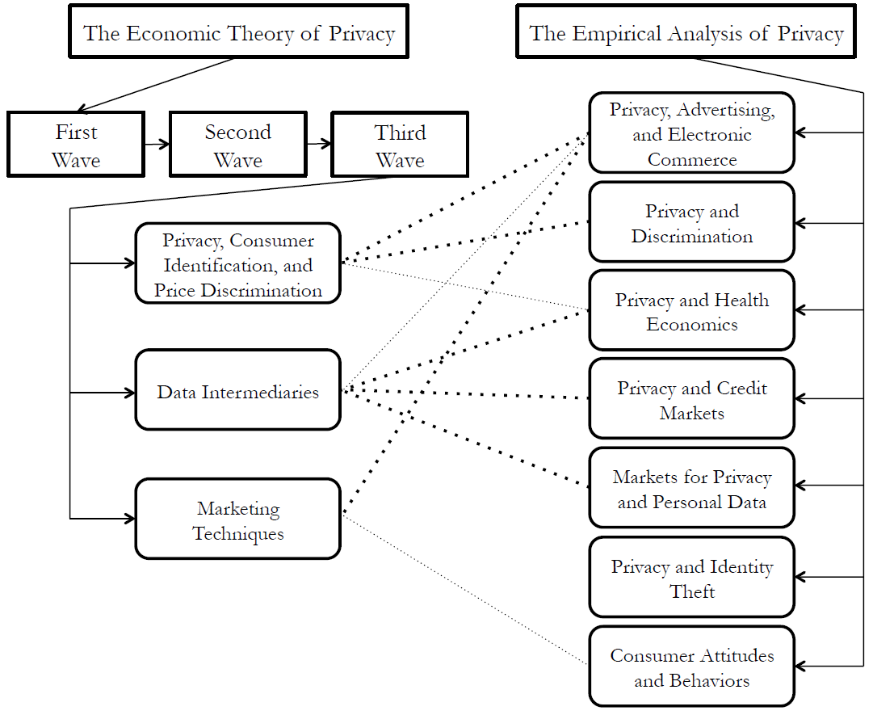

Slide 13
Agenda
A brief history of the economics of privacy
Some open issues
A few conclusions

Slide 14
Many open questions…
What are the costs of privacy intrusions?
  Tangible vs. intangible harms
What is the “optimal” amount of privacy protection?
  And, for which stakeholder?
Who should provide that “optimal” amount of privacy?
  Individuals (informed consent, market choices)?
  The market (self-regulation)?
  Government (regulation)?
Are there privacy market failures?
  Do revealed preferences capture actual privacy preferences? Do they capture actual privacy harm?

Slide 15
And even more issues…

Slide 16
Privacy concerns are puzzling for economists |  | There are clear economic arguments for privacy
Personal information is the lifeblood of the Internet |  | How is the surplus generated by personal data allocated?
Sharing personal data is an economic win-win |  | When do consumers benefit from trades in their data?
Loss of privacy is the price to pay for the benefits of big data |  | Who bears the costs of privacy enhancing technologies?
Notes:
16

Slide 17
Privacy concerns are puzzling for economists |  | There are clear economic arguments for privacy
Personal information is the lifeblood of the Internet |  | How is the surplus generated by personal data allocated?
Sharing personal data is an economic win-win |  | When do consumers benefit from trades in their data?
Loss of privacy is the price to pay for the benefits of big data |  | Who bears the costs of privacy enhancing technologies?
Notes:
17

Slide 18
Privacy concerns are puzzling for economists |  | There are clear economic arguments for privacy
Personal information is the lifeblood of the Internet |  | How is the surplus generated by personal data allocated?
Sharing personal data is an economic win-win |  | When do consumers benefit from trades in their data?
Loss of privacy is the price to pay for the benefits of big data |  | Who bears the costs of privacy enhancing technologies?
Notes:
18

Slide 19
Privacy concerns are puzzling for economists |  | There are clear economic arguments for privacy
Personal information is the lifeblood of the Internet |  | How is the surplus generated by personal data allocated?
Sharing personal data is an economic win-win |  | When do consumers benefit from trades in their data?
Loss of privacy is the price to pay for the benefits of big data |  | Who bears the costs of privacy enhancing technologies?
Notes:
19

Slide 20
Privacy concerns are puzzling for economists |  | There are clear economic arguments for privacy
Personal information is the lifeblood of the Internet |  | How is the surplus generated by personal data allocated?
Sharing personal data is an economic win-win |  | When do consumers benefit from trades in their data?
Giving up privacy is necessary to extract the benefits of big data |  | Who bears the costs of privacy enhancing technologies?
Notes:
20

Slide 21
Farrell (2012): privacy as…
an intermediate good
a final good

Slide 22
Farrell (2012): privacy as…
an intermediate good
a final good
Identity theft, price discrimination, discrimination, blackmailing, adverse profiling, other objective harms (Calo 2013)….
Psychological discomfort, stigma, loss of autonomy, infringement on freedom, other subject harms….

Slide 23
an intermediate good

Slide 24
the economic impact of privacy…
welfare allocation (“micro” angle)
aggregate welfare (“macro” angle)

Slide 25
the economic impact of privacy…
welfare allocation

Slide 26
Posner/Stigler: privacy is redistributive
… but so is the lack of privacy
Varian (1996): consumers would rationally want telemarketers to know what products they are interested in, but not how much they are interested in those products

Slide 27
  Taylor (2004), Acquisti and Varian (2005)
    Under tracking and targeting, myopic customers get price discriminated in intertemporal dynamic pricing model
    I.e., in absence of privacy protection, consumers are worse off
    Note: we are talking first degree price discrimination:
    all consumers (high and low) pay their reservation prices

Slide 28
the economic impact of privacy…
welfare allocation: there is a rational economic argument for privacy as a private good

Slide 29
the economic impact of privacy…
welfare allocation: there is a rational economic argument for privacy as a private good
    caveats: 1st degree PD may or may not increase aggregate welfare; externalities; ….

Slide 30
the economic impact of privacy…
welfare allocation: there is a clear, rational economic argument for privacy as a private good aggregate welfare: what about the aggregate, value of personal information?

Slide 31
Econ Theory: Privacy is bad
Obstacles to data sharing create economic inefficiencies
  Posner (1978, 1981); Stigler (1980)

Slide 32
Econ Theory: Privacy is good
In absence of regulation, excessive data collection harms economic efficiency
E.g., competition pushes firms to invest more than socially optimal amount in gathering consumer data; competitive pressure leads to divergence between private and social marginal benefits of information acquisition
  Hirshleifer (1971); Taylor (2008); Burke, Taylor, Wagman (2011);
  Hermalin and Katz (2006)

Slide 33
Privacy concerns are puzzling for economists |  | When is privacy welfare enhancing/decreasing?
Personal information is the lifeblood of the Internet |  | How is the surplus generated by personal data allocated?
Sharing personal data is an economic win-win |  | When do consumers benefit from trades in their data?
Giving up privacy is necessary to extract the benefits of big data |  | Who bears the costs of privacy enhancing technologies?
Notes:
33

Slide 34
Privacy does not make economic sense |  | There are clear economic arguments for privacy
Sharing personal data is an economic win-win |  | How is the surplus generated by personal data allocated?
onal information is the lifeblood of the Internet |  | When do consumers benefit from trades in their data?
Giving up privacy is necessary to extract the benefits of big data |  | Who bears the costs of privacy enhancing technologies?
Notes:
34

Slide 35
What is the economic impact of targeted advertising?
Literature Frame 1
Literature Frame 2
Consumers
Consumers
Information asymmetry
Data industry:
Reduces search costs
Data industry:
Extracts surplus
Oligopoly
Merchants
Merchants
Competition

Slide 36
Privacy does not make economic sense |  | There are clear economic arguments for privacy
Sharing personal data is an economic win-win |  | When do consumers benefit from trades in their data?
Giving up privacy is necessary to extract the benefits of big data |  | Who bears the costs of privacy enhancing technologies?
Notes:
36

Slide 37
Privacy does not make economic sense |  | There are clear economic arguments for privacy
 |  | How is the surplus generated by personal data allocated?
Personal information is the lifeblood of the Internet
Giving up privacy is necessary to extract the benefits of big data |  | Who bears the costs of privacy enhancing technologies?
Notes:
37

Slide 38
Could you get an email account for free in 2002?
Could you have an online social networking profile for free in 2002?
Could you use search engines for free in 2002?
Could you post classifieds for free in 2002?
Could you read online news free in 2002?
…

Slide 39
What causal evidence links a) increasing collection of consumer data in the last decade (i.e., “privacy MCost”) and b) increased/improved provision of free services and free content (i.e., “MBenefit”)?
If economic surplus is generated by more sophisticated and granular consumer tracking, which economic agents are appropriating that surplus?

Slide 40
Privacy does not make economic sense |  | There are clear economic arguments for privacy
Personal information is the lifeblood of the Internet |  | How is the surplus generated by personal data allocated?
Giving up privacy is necessary to extract the benefits of big data |  | Who bears the costs of privacy enhancing technologies?
Notes:
40

Slide 41
Privacy does not make economic sense |  | There are clear economic arguments for privacy
Personal information is the lifeblood of the Internet |  | How is the surplus generated by personal data allocated?
Sharing personal data is an economic win-win |  | When do consumers benefit from trades in their data?
Loss of privacy is the price to pay for the benefits of big data |  | Who bears the costs of privacy enhancing technologies?
Notes:
41

Slide 42
Privacy and innovation
Privacy regulation reduces technology adoption/innovation
  Miller and Tucker (2009, …)
Privacy regulation increases technology adoption/innovation
  Adjerid, Acquisti, Telang, Padman, Adler-Minstein (2015)
  (The key seems to be what type of regulation)

Slide 43





Slide 44
Privacy Enhancing Technologies (PETs) allow, among other things
  Authentication without identification…
  Private information retrieval…
  Searches in encrypted spaces…
  Operations on encrypted spaces…
  Privacy-preserving data mining, collaborative filtering, targeted advertising…

Slide 45
Privacy does not make economic sense |  | There are clear economic arguments for privacy
Personal information is the lifeblood of the Internet |  | How is the surplus generated by personal data allocated?
Sharing personal data is an economic win-win |  | When do consumers benefit from trades in their data?
Loss of privacy is the price to pay for the benefits of big data |  | Who would bear the costs of privacy enhancing technologies?
Notes:
45

Slide 46
Privacy does not make economic sense |  | When is privacy welfare enhancing/decreasing?
Sharing personal data is an economic win-win |  | When do consumers benefit from trades in their data?
Personal information is the lifeblood of the Internet |  | How is the surplus generated by personal data allocated?
Loss of privacy is the price to pay for the benefits of big data |  | Who would bear the costs of privacy enhancing technologies?
Notes:
46

Slide 47
Agenda
A brief history of the economics of privacy
Some open issues
A few conclusions

Slide 48
A few conclusions
So far, no unified economic theory of privacy (none on the horizon, either)
At the micro level, rational economic argument for privacy
At the macro level, effects much more nuanced. Positive, negative, indeterminate - depending on context
PETs *may* allow us to have the cake and eat it too
What we (intentionally) ignored:
  Non-economic dimensions of privacy (freedom, autonomy,..)
  The behavioral economics of privacy, problems with informed consent

Slide 49
For more information
“The Economics of Privacy,” Acquisti, Taylor, and Wagman, Journal of Economic Literature, (2016)
“Privacy and Human Behavior in the Age of Information”, Acquisti, Brandimarte, and Loewenstein, Science, (2015)
http://www.heinz.cmu.edu/~acquisti/
(or google/bing “economics privacy”)

