Slide 1
Privacy in the Age of Augmented Reality: (Re)Framing the Debate
Alessandro Acquisti
Carnegie Mellon University
Singapore Management University, Presidential Lecture, 2015

Slide 2
People don’t really care about privacy |  | People value both sharing and protecting information
Privacy is about having something to hide |  | Any personal information can be sensitive
Privacy is about transparency and control |  | Privacy is about protection from control
Big data will be an economic win-win |  | Data trades are redistributive
Notes:
2

Slide 3
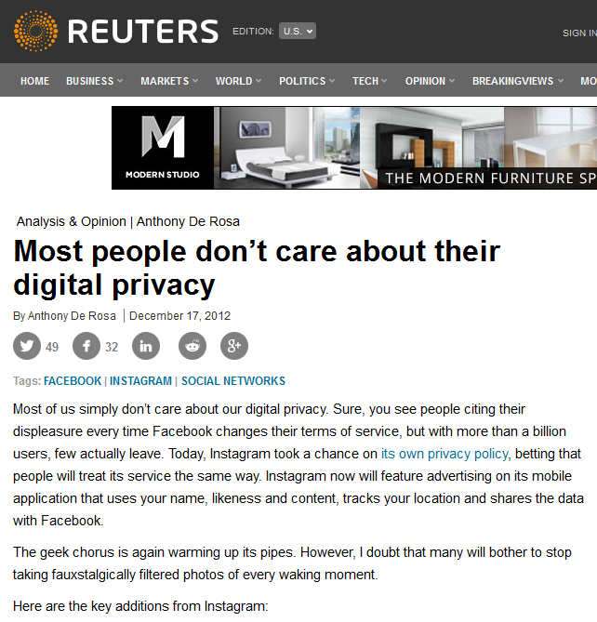

Slide 4
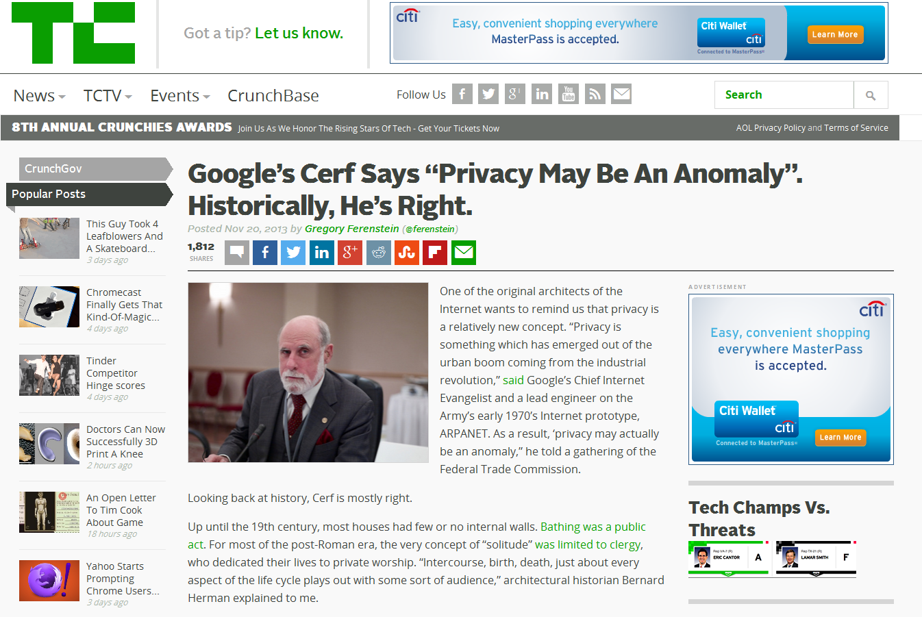

Slide 5
“Privacy and Human Behavior in the Age of Information”, Acquisti, Brandimarte, and Loewenstein, Science, 2015

Slide 6


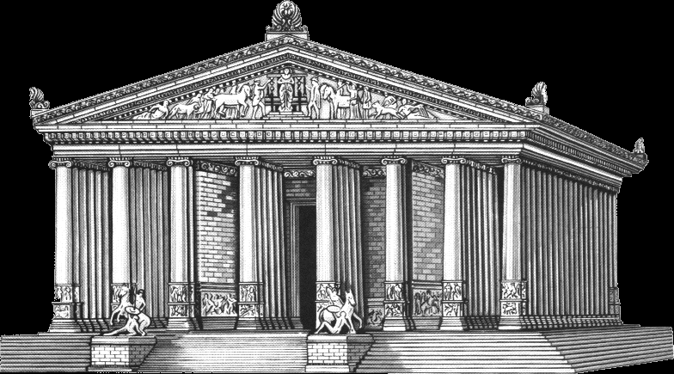
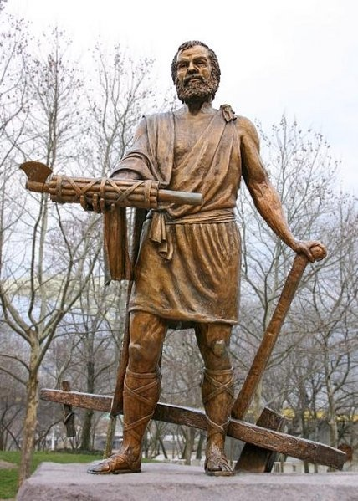

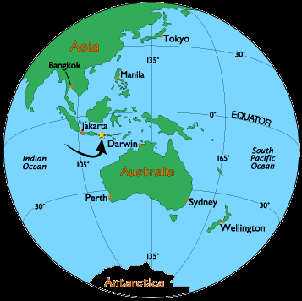

Slide 7
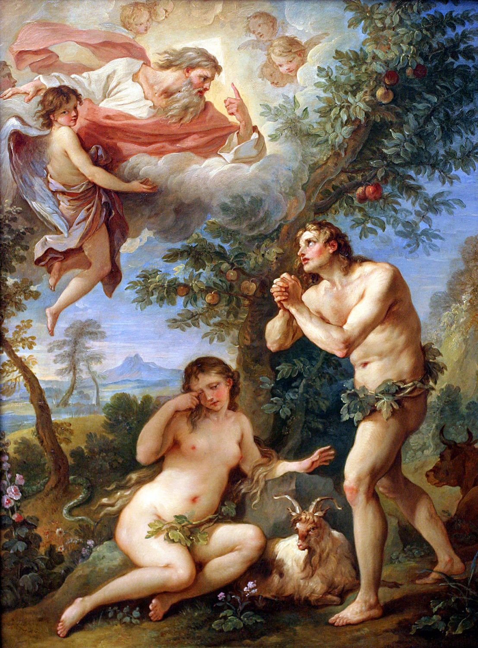

Slide 8
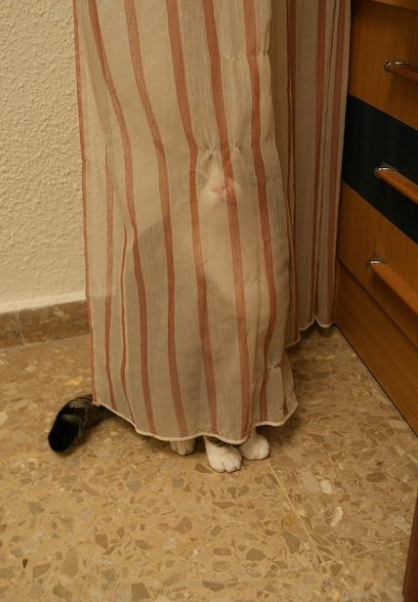

Slide 9
Why should we care?
Privacy norms, desires, expectations, and behaviors take profoundly different forms across cultures and societies
And yet, evidence of privacy seeking behavior seems to be found in all cultures across time and space
Altman (1977): Privacy is simultaneously culturally universal and culturally specific

Slide 10
Ok, but why?
An evolutionary conjecture (Acquisti, Brandimarte, Hancock, 2015)
Our responses to threats in the physical world may be sensitive to sensorial stimuli (physical, auditory, visual, olfactory, …) signaling proximous, ‘extraneous’ presences, and which we have evolved to use as cues of potential risk
So-called privacy concerns may be evolutionary by-products of those visceral responses

Slide 11
Four sets of lab experiments (N > 800) manipulating ability to detect physical presence of a stranger via sensorial stimuli
Proximity stimulus
Visual stimulus
Auditory stimulus
Olfactory stimulus
“Online Self-Disclosure and Offline Threat Detection," Alessandro Acquisti, Laura Brandimarte, and Jeff Hancock, WEIS, 2015.

Slide 12
Why should we care?
Sensorial cues we evolved to use to detect threats are absent, subdued, or even manipulated, in cyberspace
This may help explain…
Why it is so hard to protect privacy online…
Why the design of privacy (and security) technologies may need to consider visceral interventions…
Why privacy is very much contextual – and privacy behaviors at times seemingly paradoxical

Slide 13
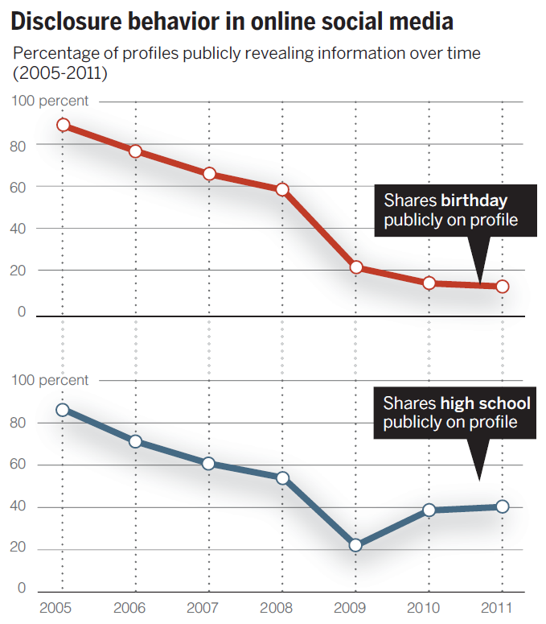
“Privacy and Human Behavior in the Age of Information," Alessandro Acquisti, Laura Brandimarte, and George Loewenstein. Science, 2015

Slide 14
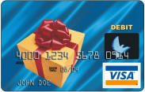
$10
Anonymous
$12
Tracked
"What is Privacy Worth?," Alessandro Acquisti, Leslie John, and George Loewenstein. Journal of Legal Studies, 2013.

Slide 15
Percentage choosing $10 card
N = 349, p>0.005
"What is Privacy Worth?," Alessandro Acquisti, Leslie John, and George Loewenstein. Journal of Legal Studies, 2013.

Slide 16
People don’t really care about privacy |  | People value both sharing and protecting information
Privacy is about having something to hide |  | Any personal information can be sensitive
Privacy is about transparency and control |  | Privacy is about protection from control
Big data will be an economic win-win |  | Data trades are redistributive
Notes:
16

Slide 17
Your consumers don’t really care about privacy |  | People value both sharing and protecting information
Privacy is about having something to hide |  | Any personal information can be sensitive
Privacy is about transparency and control |  | Privacy is about protection from control
Big data will be an economic win-win |  | Data trades are redistributive
Notes:
17

Slide 18
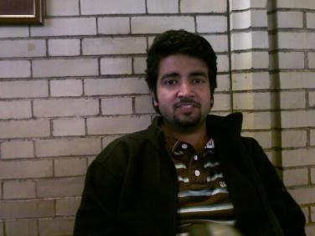
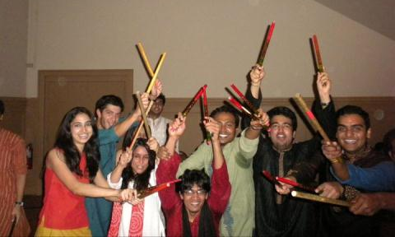
Heinz College foyer
Facebook
“Faces of Facebook: Privacy and Face Recognition in the Age of Augmented Reality," Alessandro Acquisti, Ralph Gross, and Fred Stutzman, Journal of Privacy and Confidentiality, 2014.
Notes:
18

Slide 19
1 out of 3 subjects identified
“Faces of Facebook: Privacy and Face Recognition in the Age of Augmented Reality," Alessandro Acquisti, Ralph Gross, and Fred Stutzman, Journal of Privacy and Confidentiality, 2014.

Slide 20
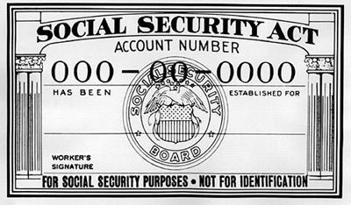

+
= SSN
“Predicting Social Security Numbers from Public Data," Alessandro Acquisti and Ralph Gross, Proceedings of the National Academy of Science, 2009.
Notes:
20

Slide 21
Can you do 1+1?

Slide 22

+
= SSN
“Faces of Facebook: Privacy and Face Recognition in the Age of Augmented Reality," Alessandro Acquisti, Ralph Gross, and Fred Stutzman, Journal of Privacy and Confidentiality, 2014.
Notes:
22

Slide 23
27% of subjects’ first 5 SSN digits identified (with 4 attempts)
“Faces of Facebook: Privacy and Face Recognition in the Age of Augmented Reality," Alessandro Acquisti, Ralph Gross, and Fred Stutzman, Journal of Privacy and Confidentiality, 2014.

Slide 24
Data “accretion”
Facebook, LinkedIn, Org Rosters, …
Anonymous face
Matching
face
Presumptive name
Inferable sensitive information
Online available information
SSNs, Credit score, political /sexual orientation, …
Demographics, Interests, Friends, …
Notes:
24

Slide 25
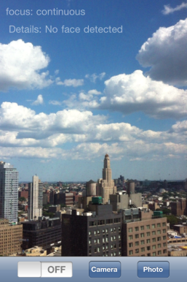
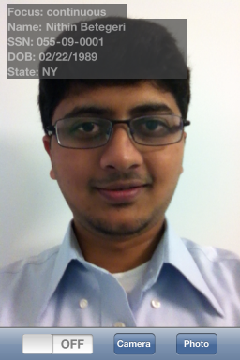
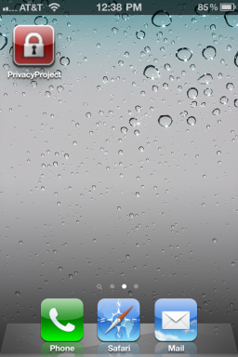


Slide 27
Your consumers don’t really care about privacy |  | People value both sharing and protecting information
Privacy is about having something to hide |  | Any personal information can be sensitive
Privacy is about transparency and control |  | Privacy is about protection from control
Big data will be an economic win-win |  | Data trades are redistributive
Notes:
27

Slide 28
Your consumers don’t really care about privacy |  | People value both sharing and protecting information
Privacy is about having something to hide |  | Any personal information can be sensitive
Privacy is about transparency and control |  | Privacy is about protection from control
Big data will be an economic win-win |  | Data trades are redistributive
Notes:
28

Slide 29
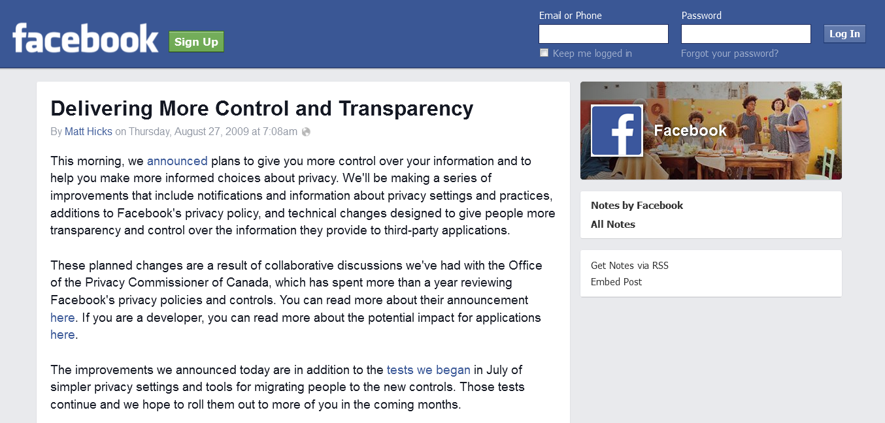

Slide 30
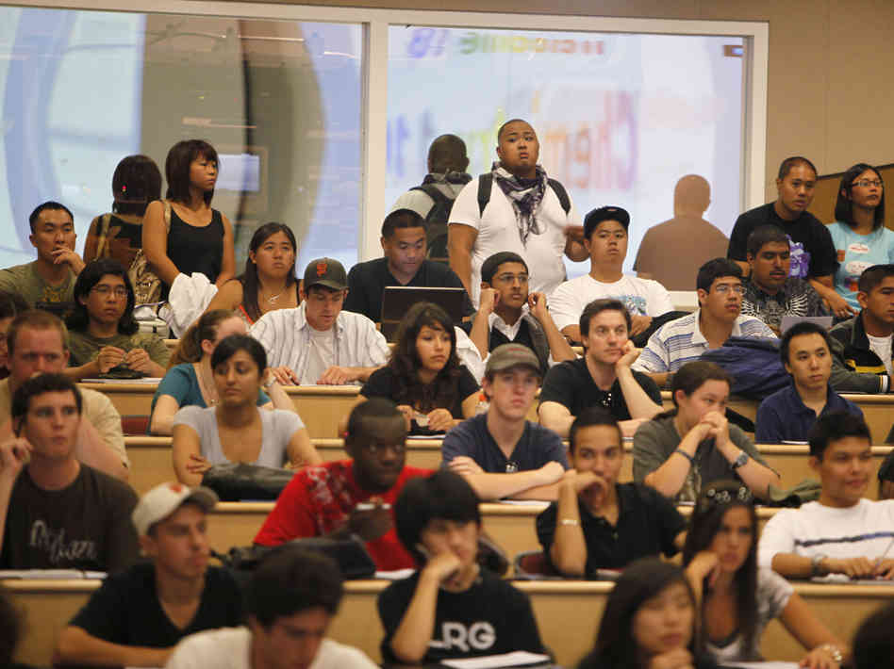
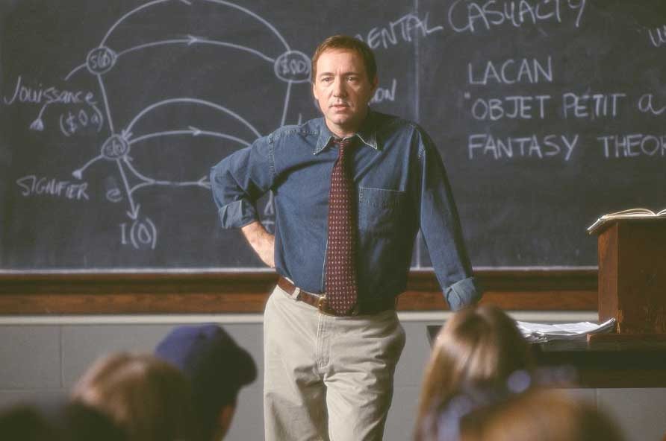
>
“Sleight of Privacy," Idris Adjerid, Alessandro Acquisti, Laura Brandimarte, and George Loewenstein. SOUPS, 2013
Notes:
30

Slide 31
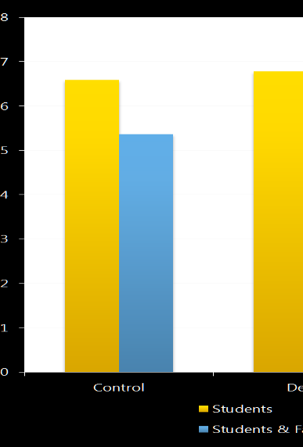
p<.01
p>.05
Response rates
N = 282
“Sleight of Privacy," Idris Adjerid, Alessandro Acquisti, Laura Brandimarte, and George Loewenstein. SOUPS, 2013

Slide 32
“Sleight of Privacy," Idris Adjerid, Alessandro Acquisti, Laura Brandimarte, and George Loewenstein. SOUPS, 2013
Notes:
32

Slide 33

“Sleight of Privacy," Idris Adjerid, Alessandro Acquisti, Laura Brandimarte, and George Loewenstein. SOUPS, 2013
Notes:
33

Slide 34
15 seconds delay
“Sleight of Privacy," Idris Adjerid, Alessandro Acquisti, Laura Brandimarte, and George Loewenstein. SOUPS, 2013
Notes:
34

Slide 35
p<.01
p>.05
Response rates
N = 282
“Sleight of Privacy," Idris Adjerid, Alessandro Acquisti, Laura Brandimarte, and George Loewenstein. SOUPS, 2013

Slide 36
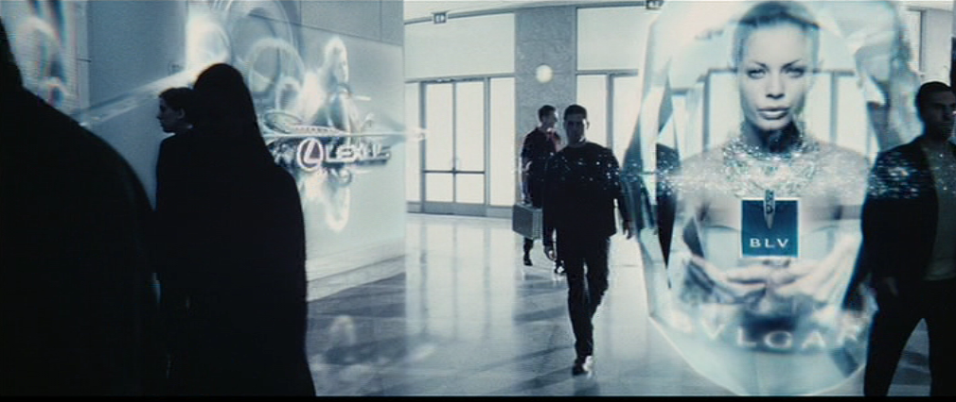

Slide 37
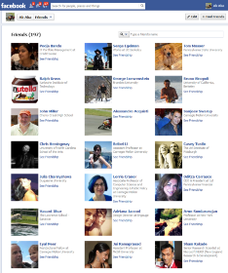



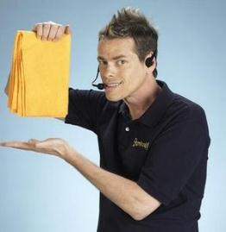
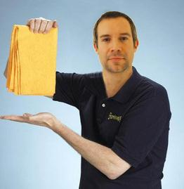
Visceral targeting

Slide 38
Your consumers don’t really care about privacy |  | People value both sharing and protecting information
Privacy is about having something to hide |  | Any personal information can be sensitive
Privacy is about transparency and control |  | Privacy is about protection from control
Big data will be an economic win-win |  | Data trades are redistributive
Notes:
38

Slide 39
Your consumers don’t really care about privacy |  | People value both sharing and protecting information
Privacy is about having something to hide |  | Any personal information can be sensitive
Privacy is about transparency and control |  | Privacy is about protection from control
Big data will be an economic win-win |  | Data trades are redistributive
Notes:
39

Slide 40
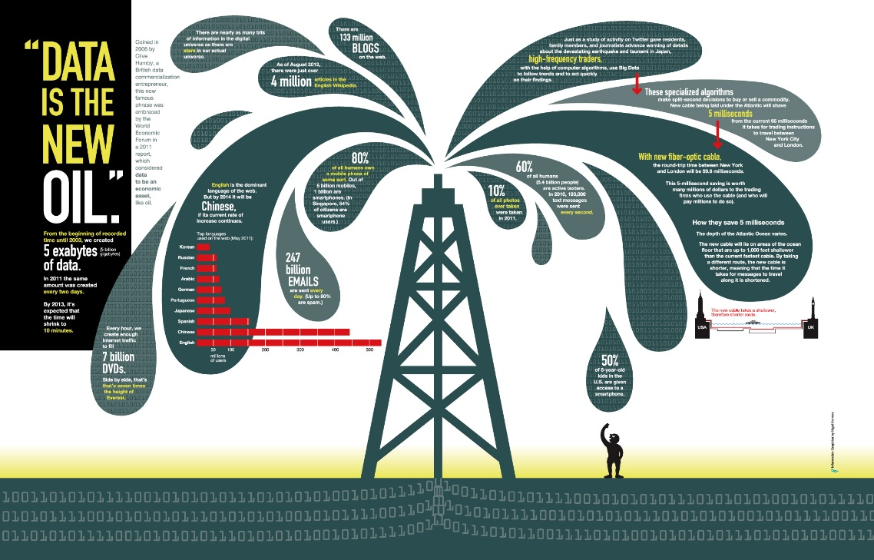
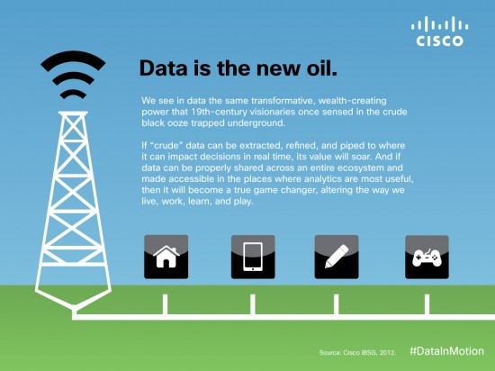
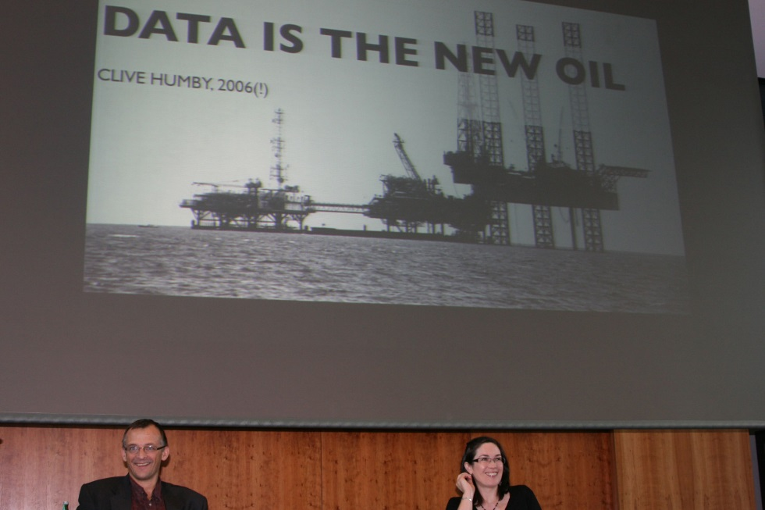
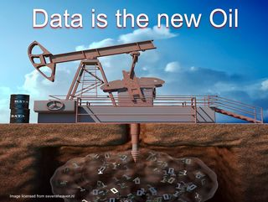
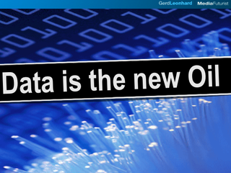


Slide 41
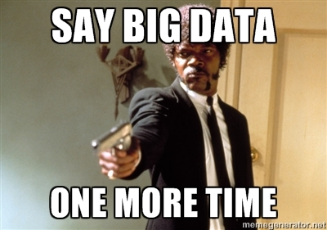

Slide 42
“The Economics of Privacy,” Acquisti, Taylor, and Wagman, Journal of Economic Literature, 2016 (forthcoming)

Slide 43
Example: The Empirics of Health Privacy
Privacy reduces technology adoption/innovation
Miller and Tucker, 2009
Privacy increases technology adoption/innovation
Adjerid, Acquisti, Padman, and Telang, 2015

Slide 44



Real Time Bidding (RTB)
Ad Exchange
“Consumers at Auction," Veronica Marotta, Alessandro Acquisti, and Kaifu Zhang, ICIS 2015

Slide 45






Ad Exchange
Impression
Users parameters
Cookies
“Consumers at Auction," Veronica Marotta, Alessandro Acquisti, and Kaifu Zhang, ICIS 2015

Slide 46

Ad Exchange
Impression
Users parameters
Cookies
“Consumers at Auction," Veronica Marotta, Alessandro Acquisti, and Kaifu Zhang, ICIS 2015

Slide 47
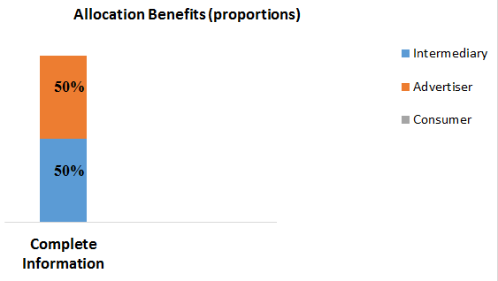

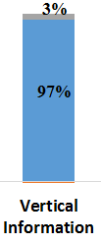

Welfare analysis
100
“Consumers at Auction," Veronica Marotta, Alessandro Acquisti, and Kaifu Zhang, ICIS 2015

Slide 48
Your consumers don’t really care about privacy |  | People value both sharing and protecting information
Privacy is about having something to hide |  | Any personal information can be sensitive
Privacy is about transparency and control |  | Privacy is about protection from control
Big data will be an economic win-win |  | (Lack of) privacy is redistributive
Notes:
48

Slide 49
People don’t really care about privacy |  | People value both sharing and protecting information
Privacy is about having something to hide |  | Any personal information can be sensitive
Privacy is about transparency and control |  | Privacy is about protection from control
Big data will be an economic win-win |  | (Lack of) privacy is redistributive
Notes:
49

Slide 50
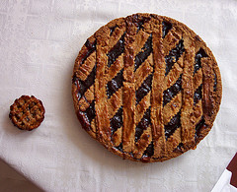
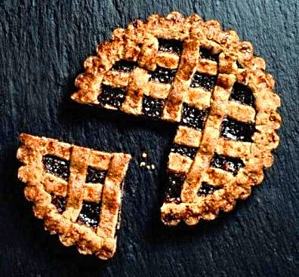
What “big data” do we want?

Slide 51


For more information
Google/Bing: economics privacy
Visit: http://www.heinz.cmu.edu/~acquisti/economics-privacy.htm
Email: acquisti@andrew.cmu.edu
Notes:
51

