Slide 2
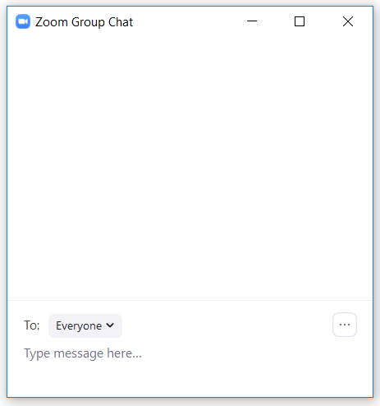
Zoom Logistics
Meeting is being recorded
Mute to avoid background noise
View: Exit Full Screen or Active Speaker View
If your audio sounds choppy, try stopping your video
Functions we will use today for audience questions:
Chat
Yes / No buttons

Slide 3
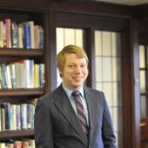
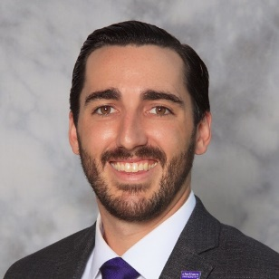
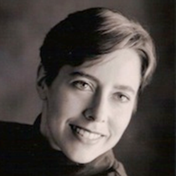
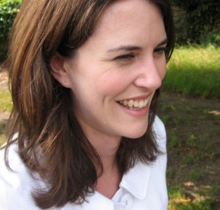
Master of Arts Management (MAM) Team It Takes a Village!
Jessica Bowser Acrie
Program Director and Academic Advisor
Ross Reilly
Senior Academic Coordinator
Matthew Spangler
Assistant Director, Career Services
Brett Crawford
Faculty Chair and Academic Advisor
Adjunct Faculty
David Gurwin, Esq. – Arts/Entertainment Lawyer, Buchanan Ingersoll
Kevin McMahon - CEO, Pittsburgh Cultural Trust
James McMahon – Chief Executive Officer, Educational Foundation, Community College of Allegheny County
Randal Miller – Director of Programming, Pittsburgh Cultural Trust
Jeff Poulin – Arts Education Manager, Americans for the Art
Leslie Donaldson
Academic Advisor and Faculty
(in addition to the super helpful Admissions and Financial Aid staff, alumni, and your peers too!)

Slide 4
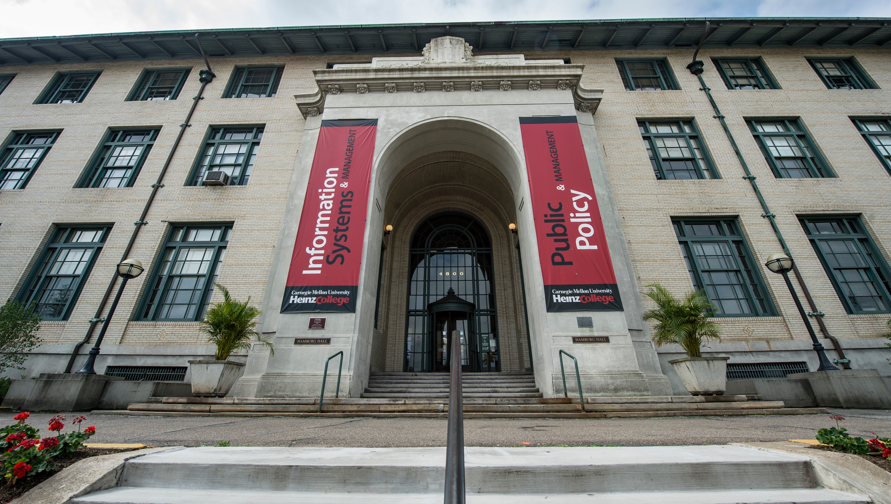
Either way: CMU is Committed to MAM Community*
This Fall: Pittsburgh or Remote?
Pittsburgh
Campus, Hamburg Hall
Remotely
*Communities aren’t perfect. Communities take effort and investment from all people involved whether in-person, on-line, or social distancing.

Slide 5
Say Hello!

Slide 6
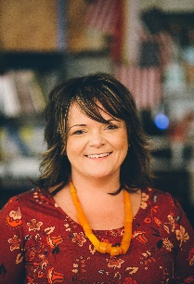
Hello my name is Jessica! Pronouns: She/Her/Hers
Current Role
Director, Master of Arts Management Program
Areas of Expertise
Navigating Bureaucracy
Relationship Management
Career Advising
Fundraising
Event Management
Ticketing
Networking
20 Years Arts Experience
Individual Giving Manager
NYC Union Box Office Manager
Theatre Producer
General Management
Telefundraiser
Program Coordinator
Playwright
Fiber Arts
Education
MAM, Carnegie Mellon University
BFA, Point Park University
Email:
Jabowser@cmu.edu

Slide 7
Summer 2020 MAM Orientation Schedule
Cohort | Date | Time | Duration | Topic
MAM/MEIM | Monday 6.29.2020 | 6:00pm LA/9:00pm Pitt/ 9:00am Beijing | 45 -60 minutes | Ask Me Anything: Placement Exams
MAM/MEIM | Monday 7.20.2020 | 9am LA/12:00pm Pittsburgh/ 12:00am Beijing | 45 minutes | Digital Toolbox for Success
MAM/MEIM | Monday 7.27.2020 | 9:00am LA/ 12:00pm Pittsburgh/ 12:00am Beijing | 45 -60 minutes | MAM/MEIM Faculty Panel
MAM | Monday 8.10.2020 | 9:00AM Pittsburgh / 9:00pm Beijing; 1:00pm Pittsburgh | 1 hour 15 mins | Curriculum Overview

Slide 8
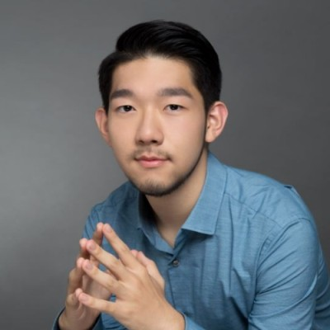
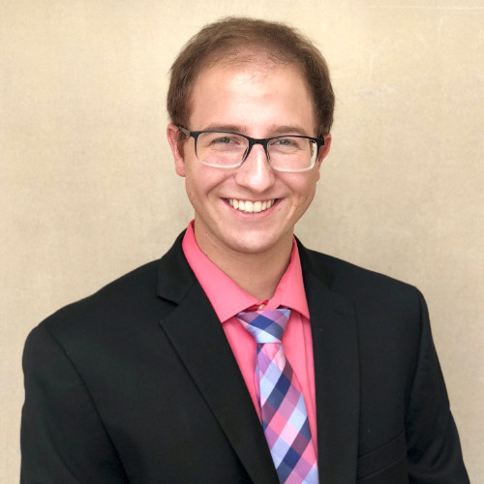
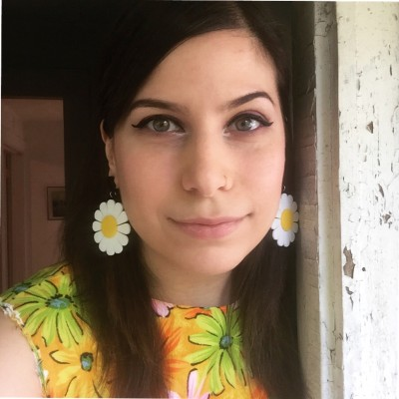
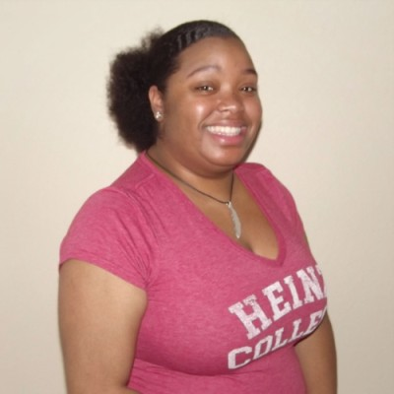
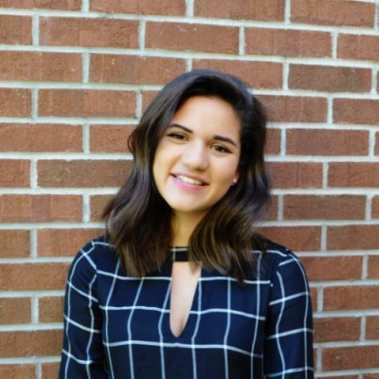
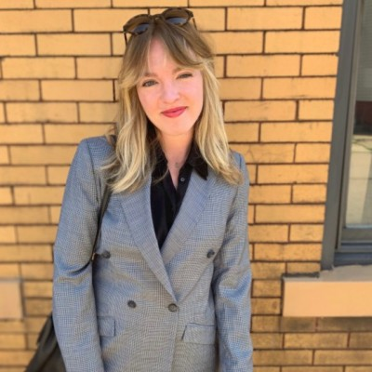
MAM 2s Meet MAM 1s Zoom Panel
Tristan Pang, MAM-GIOCA | Gino Mollica, MAM AMP | Michelle Meged, MAM
Daral Moore-Washington, MAM | Ana Garcia-Maunez, MAM | Morgan Kasprowicz, MAM
Session A: 9:00 AM EST
Session B: 1:00 PM EST

