Slide 1
An Experiment in Hiring Discrimination via Online Social Networks
Alessandro Acquisti and Christina Fong
Carnegie Mellon University
Heinz Seminars, March 2014

Slide 2
In the U.S., it is risky* for employers to ask interview questions about…
Family status and plans…
Religious orientation…
Political orientation…
Sexual orientation…
However…

Slide 3
…. many candidates nowadays volunteer that information online

Slide 4
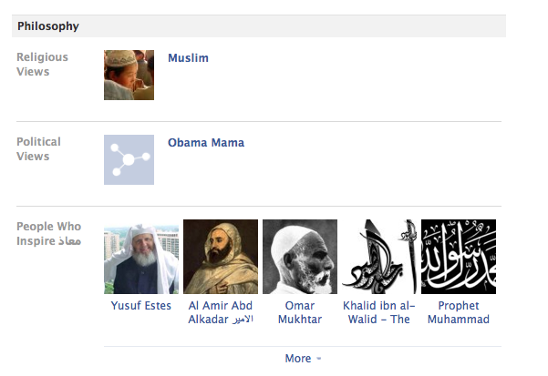

Slide 5
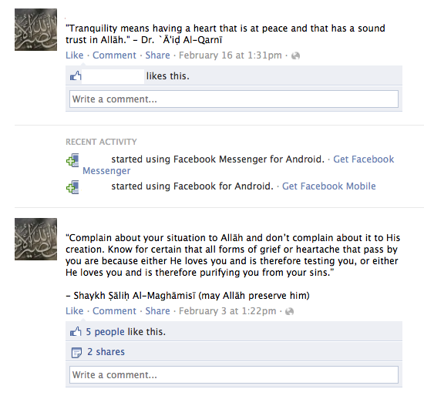

Slide 6
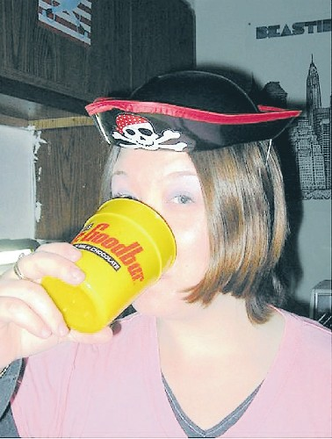

Slide 7
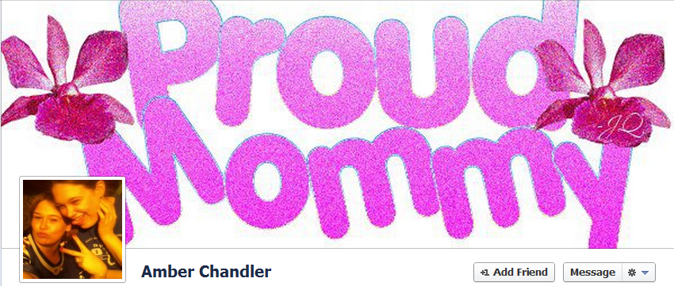

Slide 10
U.S. employers have started using social media to find information about job applicants
61% googled job candidates…
51% reviewed available information on MySpace, Facebook or other social networking sites…
57% reviewed available blog entries…
34% did not hire the person based on what they found…
Sources: 2007 Ponemon Institute HR Special Analysis, 2008 Career Builder Study, 2010 Microsoft Survey

Slide 11
But the actual frequency of the phenomenon is debated
Searching not illegal, per se, but can lead to discrimination (Ponemon 2008)
Hence, some organizations are now being advised not to seek online information about prospective candidates
In fact, only a minority of employers may actually be using social media sites for hiring purposes (2012 EmploymentScreenIQ Survey)

Slide 12
Professional/Unprofessional traits on social media, according to employers
Candidate’s background supported their qualifications for the job
Candidate had great communication skills
Candidate was a good fit for the company’s culture
Candidate’s site conveyed a professional image
Candidate had great references posted about them by others
Candidate showed a wide range of interests
Candidate received awards and accolades
Candidate’s profile was creative
[…]
(From 2008 Career Builder Study)
Candidate posted information about them drinking or using drugs
Candidate posted provocative or inappropriate photographs or information
Candidate had poor communication skills
Candidate bad-mouthed their previous company or fellow employee
Candidate lied about qualifications
Candidate used discriminatory remarks related to race, gender, religion, etc. Maybe this is too much
Candidate’s screen name was unprofessional
[…]

Slide 13
Research questions
Do US employers actually seek information about job candidates online?
If so, are their hiring decisions being affected by information the candidates openly divulge on online social networks (including “protected” information)?

Slide 14
Related work
Large body of economic research on (job) discrimination, but relatively fewer field experiments
“Audit” studies
“Resumes” studies (e.g., Bertrand and Mullainathan "Are Emily and Greg More Employable than Lakisha and Jamal?“ AER 2004)

Slide 15
Our studies
Study 1: Online experiment
Spring 2012, survey experiment with over 1,000 Amazon MTurk subjects
Study 2: Field experiment
Spring 2013, resumes sent to over 4,000 U.S. employers
Common DV
Call-back (i.e. invitation to interview)

Slide 16
Approach (common to both studies)
Created “unique” names
Designed (identical) resumes associated with each name
Designed (identical) profiles on a professional social network associated with each name (LinkedIn)
Designed (manipulated) profiles on a personal social network associated with each name (Facebook)

Slide 17
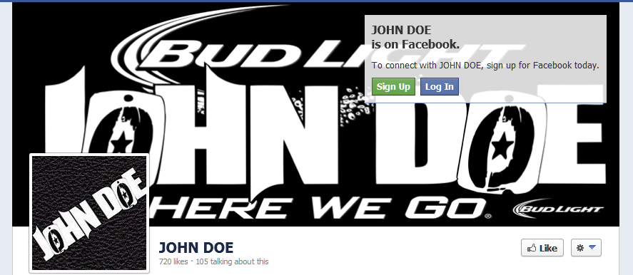
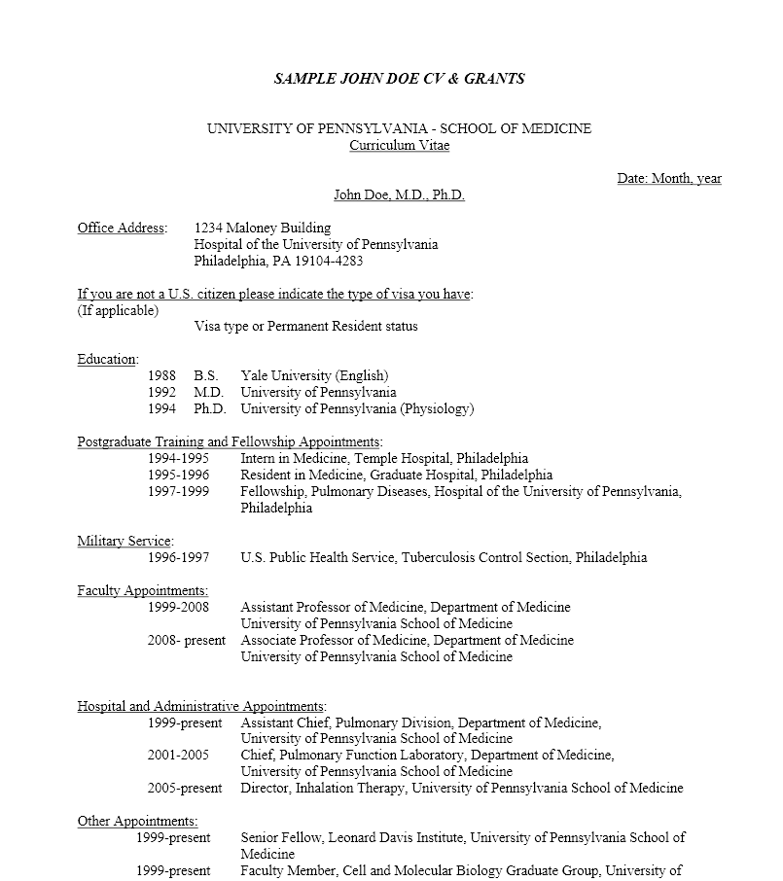
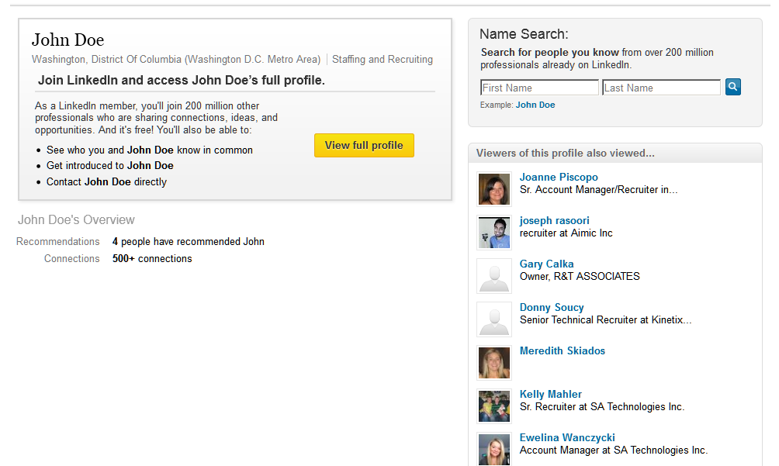
In a nutshell

Slide 18
Conditions
Our experiments focus on:
Religious orientation (Christian vs. Muslim)
Sexual orientation (Straight vs. Gay)

Slide 19
Conditions
Our experiments focus on:
Religious orientation (Federal protection)
Sexual orientation (State protection)

Slide 20
Conceptual model
Employer’s JDM, heuristics, biases
Employer checks profile?
Candidate reveals traits on profile?
Candidate’s traits

Slide 21
Designing a “real fake” social media profile

Slide 22
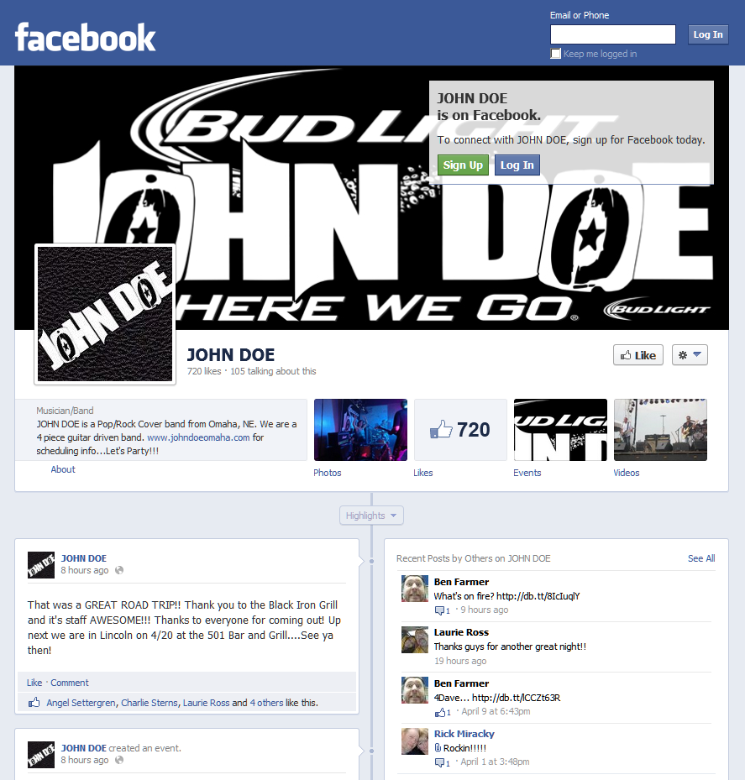
Timeline Image
Profile Image
Name
Close ended fields (e.g., Likes)
Personal Information
Friends
Open ended fields (e.g., status updates)

Slide 23
Interpreting a null result
A null result (call-back rates equivalent across conditions) could be due to a number of different reasons:
Employers do not search for candidates
We control for that using Google AdWords and Premiere accounts
Employers search, but don’t find our profiles
We control for that by choosing and testing high-ranked names
Our manipulations don’t work
We control for that using the online experiment
Employers search, but only later on in the hiring process
Employers do not discriminate based on traits we manipulated

Slide 24
Study 1: Online experiment
Spring 2012
1,170 subjects recruited via Amazon MTurk
4 conditions between-subject design
Links to resumes, LinkedIn, and Facebook profiles
Plus, another 4 “control” conditions only with links to resumes and LinkedIn profiles

Slide 25
Study 1 : Questionnaire
Attention checks
DVs: Imagine you are an HR person…
Would you call this candidate for an interview? (Binary)
Additional Likert questions about employability
Manipulation checks
Open-ended questions
Demographics

Slide 26
Study 1: Results
Manipulation checks
Call-back ratios
Regression analysis
Success of deception

Slide 27
Study 1: Manipulation checks
Successful

Slide 28
Study 1: Call-back ratios, all subjects
 | Self would call for interview [0,1]
Christian | 94.78%
Muslim | 92.68%
 | {n.s.}
Straight | 94.44%
Gay | 94.06%
 | {n.s.}

Slide 29
Study 1: Call-back ratios, only subjects with hiring experience
 | Call-back ratios |  | Employability Score (s.d. = 1, mean =0)
PANEL A: Religious affiliation manipulation
 | Muslim | Christian | Muslim | Christian
 | 88.03% | 96.85% | -0.326 | 0.21
N | 117 | 127 | 117 | 127
 | Two-sided Fisher’s exact p-value: 0.012 |  | Two-sided t-test p-value: 0.004
PANEL B: Sexual orientation manipulation
 | Gay | Straight | Gay | Straight
 | 93.02% | 93.80% | 0.02 | -0.08
N | 129 | 129 | 129 | 129
 | Two-sided Fisher’s exact p-value: 1.00 |  | Two-sided t-test p-value: 0.55

Slide 30
Study 1: Regression analysis
Aggregated conditions into two groups:
“Advantaged”
Straight
Christian
“Disadvantaged”
Gay
Muslim
Note: not necessarily “economically” disadvantaged, but more likely to be discriminated against (according to literature)

Slide 31
Study 1: Regression analysis (OLS; DV: employability score)
 | 2. Pooled Sample
Disadvantaged Candidate | 0.318
 | (0.276)
Hiring Experience | 0.025
 | (0.090)
Disadvantaged Candidate * Hiring Experience | -0.273**
 | (0.123)
Democrat | -0.068
 | (0.118)
Disadvantaged Candidate * Democrat | 0.319*
 | (0.183)
Independent | -0.291**
 | (0.125)
Disadvantaged Candidate * Independent | 0.440**
 | (0.185)
U.S. born | 0.394**
 | (0.193)
Disadvantaged Candidate * U.S. born | -0.537**
 | (0.238)
Constant | 0.012
 | (0.239)
Controls included? | Yes
R-squared | 0.035
N | 1,017

Slide 32
Study 1: Open-ended answers
Only 0.3% expressed doubts about the candidate’s existence

Slide 33
Open-ended answers
“[I used Google] to check if a [name of the company] really existed in [city].”
“[I searched for him] to find photos, as well as less tailored info. I found his facebook page.”
“[The LinkedIn profile] didn't affect my opinion - I think LinkedIn is really generic and not very useful. It helps verify that the person actually exists, though.”
“I don't think it is fair for the applicant to have his personal information like address and phone number given out like this. If I found out my resume was posted on mTurk I would be very angry.”

Slide 34
Study 1: No Personal profiles conditions
Also tested 4 conditions in which subjects were only provided links to Resume + LinkedIn profile
No statistically significant differences

Slide 35
Study 2: Field experiment
Spring 2013
4,152 employers (found via Indeed.com)
4 conditions between-subject design
Several job types (and corresponding resumes)
Combination of IT, managerial, and analyst positions
Note: In Bertrand and Mullainathan (2004)
Caucasian names call-back ratio ~10%; African-American call-back ratio ~6.50%

Slide 36
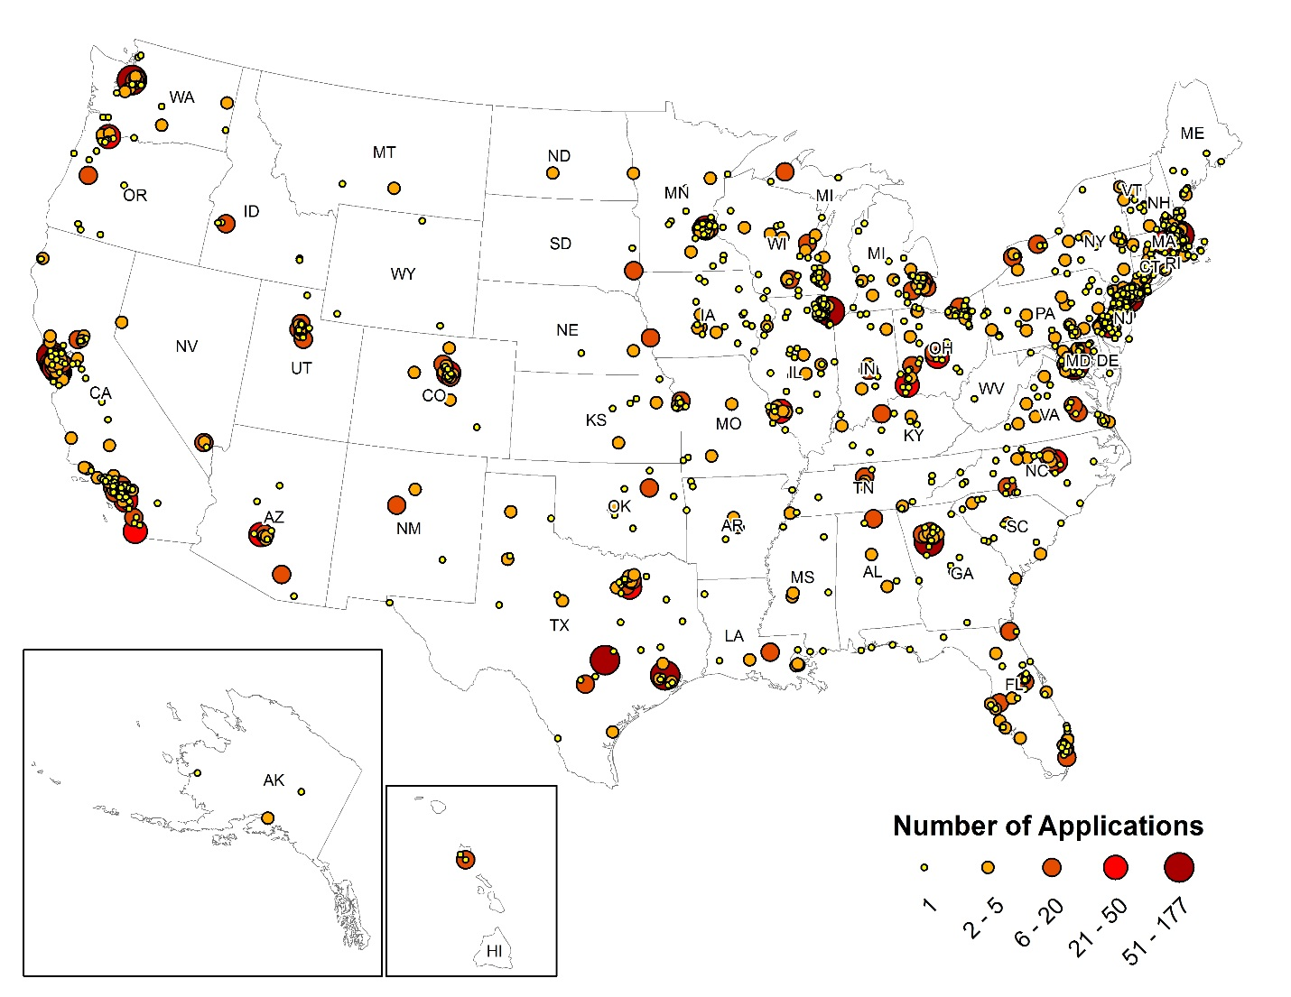
Study 2: Geographical distribution of applications

Slide 37
Study 2: Search results
Current information about employers’ online searches comes from wildly differing estimates in self-report surveys
Our (also noisy, but field) data:
Google AdWords stats
“Premiere” accounts
Lower boundary: 9.92%
Higher boundary: 27.68%

Slide 38
Study 2: Call-back ratios
 | Gay | Straight | Muslim | Christian
Interview invitations | 10.65% | 10.63% | 10.92% | 12.63%
Applications | 1,071 | 1,025 | 1,026 | 1,061

Slide 39
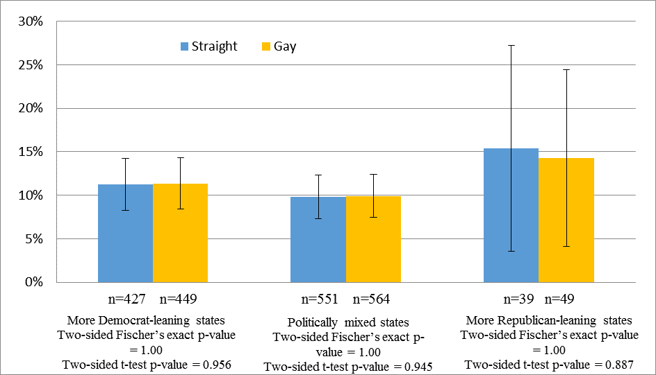
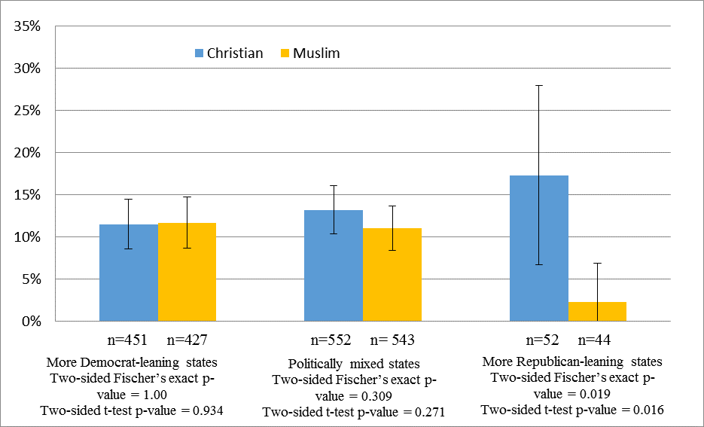
Study 2: Call-back ratios
Figure 3. Field experiment: Callback rates by political leaning of the state. The confidence interval (CI)

Slide 40
Study 2: Regressions (OLS), Religious orientation conditions
 | (1) | (2) | (3) | (4) | (5) | (6)
 | State | County | State | County | State | County
Muslim candidate | -0.150*** | -0.145** | -0.145** | -0.180** | -0.117** | -0.166**
 | (0.0572) | (0.0740) | (0.0568) | (0.0762) | (0.0571) | (0.0747)
Politically mixed area | -0.0423 | -0.111* | -0.0495 | -0.117 | -0.0228 | -0.109
 | (0.0544) | (0.0673) | (0.0574) | (0.0713) | (0.0571) | (0.0700)
Democratic area | -0.0578 | -0.108 | -0.0642 | -0.124 | -0.0290 | -0.122
 | (0.0547) | (0.0672) | (0.0720) | (0.0782) | (0.0724) | (0.0772)
Muslim*Politically mixed area | 0.129** | 0.130 | 0.125** | 0.168** | 0.0997* | 0.161**
 | (0.0604) | (0.0791) | (0.0603) | (0.0807) | (0.0604) | (0.0793)
Muslim*Democratic area | 0.152** | 0.148* | 0.146** | 0.183** | 0.115* | 0.167**
 | (0.0611) | (0.0771) | (0.0608) | (0.0793) | (0.0613) | (0.0778)
State fixed effects |  | YES |  | YES |  | YES
Geo controls |  |  | YES | YES | YES | YES
Job/Firm controls |  |  |  |  | YES | YES
Observations | 2,087 | 1,703 | 2,039 | 1,692 | 2,039 | 1,692
R2 | 0.003 | 0.031 | 0.008 | 0.042 | 0.038 | 0.074

Slide 41
Study 2: Robustness checks
Results robust to:
OSL/probit specifications
Different categorizations of states/counties by political leaning
Presidential elections
Gallup 2012 political ideology survey
Gallup 2012 political party ID survey
Union sets
HQ location vs job location
Taking 1 state off regression at a time

Slide 42
Conclusions
Online experiment provides some self-report evidence of discriminatory biases along traits we manipulated
Field experiment suggests a minority of U.S. employers actually search (at least, for the job types we applied to)
Hence, overall impact of manipulated traits is small
However, significant when controlling for state political orientation

Slide 43
Thank you
CMU RAs
National Science Foundation under Grant CNS-1012763
Carnegie Mellon CyLab
TRUST (Team for Research in Ubiquitous Secure Technology)
IWT SBO Project on Security and Privacy for Online Social Networks (SPION)

Slide 44
For more information
Google/Bing: economics privacy
Visit: http://www.heinz.cmu.edu/~acquisti/economics-privacy.htm
Email: acquisti@andrew.cmu.edu

Slide 45
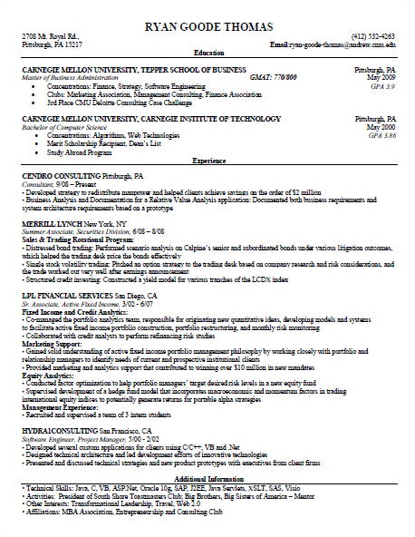
Manipulated
Randomized

Slide 46
Table 1 – Manipulation Checks H0: Frequencies of Three Belief Response Categories do not differ (p-values reported)
 | BELIEFS
CONDITIONS | Gay/ Straight | Muslim/ Christian | Kids/ NoKids | Unprofessional/Professional | Female/ Male | Attractive/ Unattractive | Married/ Single | Caucasian/ African American
NO FACEBOOK LINK PROVIDED
Gay/Straight | 0.515 | 0.129 | 0.424 | 0.878 | 0.083* | 1.000 | 0.236 | 0.520
Muslim/Christian | 0.524 | 0.820 | 0.403 | 0.465 | 0.104 | 0.717 | 0.297 | 0.194
Has kids/No kids | 0.006*** | 0.180 | 0.560 | 0.841 | 0.174 | 0.001*** | 0.054* | 0.106
Unprofessional/ Professional | 0.995 | 0.485 | 0.307 | 0.460 | 0.895 | 0.065* | 0.437 | 0.247
FACEBOOK LINK PROVIDED
Gay/Straight | 0.000*** | 0.000*** | 0.434 | 0.211 | 0.141 | 0.217 | 0.000*** | 0.915
Muslim/Christian | 0.081* | 0.000*** | 0.165 | 0.249 | 0.725 | 0.071* | 0.029** | 0.001***
Has kids/No kids | 0.088* | 0.325 | 0.000*** | 0.783 | 0.642 | 0.961 | 0.000*** | 0.143
Unprofessional/ Professional | 0.002*** | 0.661 | 0.000*** | 0.000*** | 0.928 | 0.684 | 0.000*** | 0.375

