Slide 1
Privacy in the Age of Augmented Reality
Alessandro Acquisti
(with Ralph Gross and Fred Stutzman)
Carnegie Mellon University
Joint works with: 1) Ralph Gross and Fred Stutzman; 2) Sonam Samat, Eyal Peer, Ralph Gross
National Telecommunications and Information Administration
March 25, 2014 Privacy Multistakeholder Meeting
Facial Recognition Technology

Slide 2
In 1997, the best face recognizer in the FERET program scored an error rate of 0.54 (false reject rate at false accept rate of 1 in 1000)
In 2010, the best recognizer scored 0.003
In 2000, 100 billion photos were shot worldwide, but only a minuscule proportion of them would make it online
In 2010, 2.5 billion photos per month were uploaded by Facebook users alone – many of them tagged or identified
Notes:
2

Slide 3
Converging technologies
Increasing public self-disclosures through online social networks (especially photos)
Continuing improvements in face recognizers’ accuracy
Cloud computing
Ubiquitous computing
Statistical re-identification
Notes:
3

Slide 4
Can we combine existing, publicly available online social network data with off-the-shelf face recognition technology for the purpose of large-scale, automated, real-time, peer-based…
  Individual re-identification, online and offline?
  Inference of additional, and potentially sensitive, personal data?
For more info: http://www.heinz.cmu.edu/~acquisti/face-recognition-study-FAQ/ or acquisti@andrew.cmu.edu
Notes:
4

Slide 5
Three Experiments
Experiment 1: Online-to-Online Re-Identification
Experiment 2: Offline-to-Online Re-Identification
Experiment 3: Offline-to-Online Sensitive Inferences
In all experiments, we used PittPatt (Nechyba, Brandy, and Schneiderman, 2007) for face detection and recognition
“Faces of Facebook: Privacy in the Age of Augmented Reality,"
Alessandro Acquisti, Ralph Gross, and Fred Stutzman. BlackHat, 2011
Notes:
5

Slide 6
Experiment 1
Online to online
We mined publicly available images from online social network profiles to re-identify profiles on one of the most popular dating sites in the US
Notes:
6

Slide 7
Experiment 1: Data
Identified DB: primary profile photos from Facebook profiles in a North American city, obtained via search engine queries
  Number of profiles: 277,978
  Number of images: 274,540
  Number of unique faces detected: 110,984
Notes:
7

Slide 8
Experiment 1: Data
Unidentified DB: Dating site profiles
  Search pattern: profiles within Urbanized Area of the same North American city
    Number of profiles: 5,818
    Number of faces detected: 4,959
Notes:
8

Slide 9

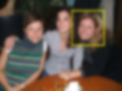
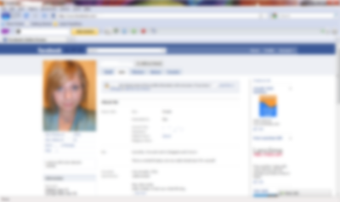
Experiment 1: In a nutshell
Unidentified Database:
Dating site photos
Identified Database: Facebook photos
Re-Identified Individual
Fictional example – not real dating site photos
Notes:
9

Slide 10
Experiment 1: Evaluation
We only considered the best matching pair for each dating site profile (i.e., conservative approach)
We compared more than 500 millions pairs using PittPatt and a commercial cloud computing cluster
  Public data, accessible technologies
We crowdsourced (via Amazon Mturk) the validation of PittPatt’s scores (i.e., 1=definitely a match, 2=likely a match, 3=unsure, 4=likely not a match, 5=definitely not a match)
Notes:
10

Slide 11
Experiment 1: Results
Unidentified Database:
Dating site Photos
Identified Database: Facebook Photos
One out of 10 dating site members identified
Re-Identified Individual
Fictional example – not real dating site photos
Notes:
11

Slide 12
Experiment 2
Offline to online
We used publicly available images from a Facebook college network to identify students walking in a campus building
Notes:
12

Slide 13
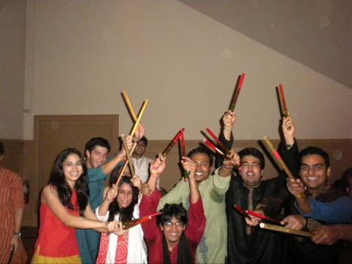

Experiment 2: Results
One out of 3 subjects identified
CMU Campus
Facebook
Notes:
13

Slide 14

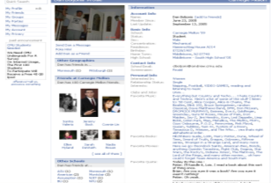

What we have shown so far
+
=
Notes:
14

Slide 15
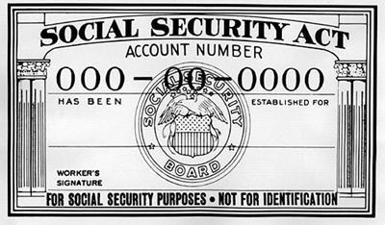
What we had done before
(Acquisti and Gross 2009)
+
= SSN
Notes:
15

Slide 16

Can you do 1+1? Experiment 3
+
27% of subjects’ first 5 SSN digits identified with four attempts - starting from their faces
= SSN
I.e., predicting SSNs (or other sensitive information) from faces
Notes:
16

Slide 17
Data “accretion”
Facebook, LinkedIn,
Org rosters, …
Anonymous face
Matching
face
Presumptive name
Inferable sensitive information
Online available information
SSNs, Credit score, Political/sexual orientation, …
Demographics, Interests, Friends, …
Notes:
17

Slide 18

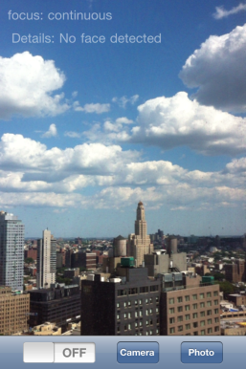
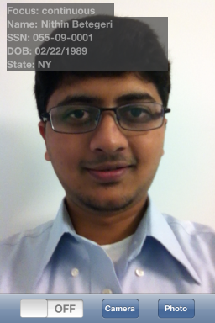
Privacy in the age of augmented reality

Slide 19
Limitations
Facial recognition of everyone/everywhere/all the time is not yet feasible
  Speed and computational costs
  Creep factor/Uncooperative subjects
  Data sources (technical and legal availability)
  Accuracy (false positives increase with size of DB)
However: technological and business trends suggest that current limitations will keep rapidly fading over time
Notes:
19

Slide 20
Extrapolations
Today
  0.000108 seconds per pair comparison (does not include upload time)
  Consider target population as including all US residents 14+ yro (about 280M)
  Assume each person has one identified frontal photo available to public or to Web 2.0 providers
  Up to more than 4 hours to find a potential match
Notes:
20

Slide 21
Extrapolations
In 10 years
  US 14+yro population about 300M
  Assume Moore’s law for cloud computing clusters
  Merely pre-classify photos into male and female faces
  Fewer than 5 minutes to find a potential match
  Or, 10 seconds using larger clusters
Notes:
21

Slide 22
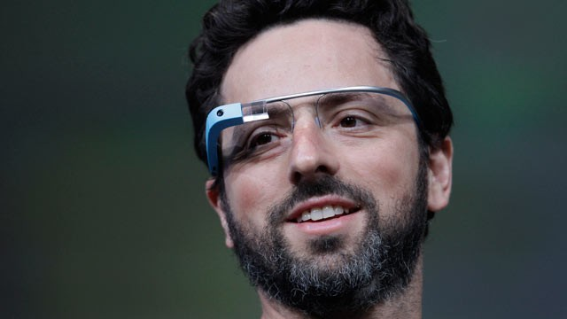

Slide 23
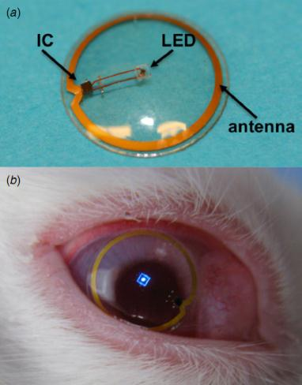

Slide 24
Developments
Improving accuracy
  Deep Face’s 97.25% accuracy on the Labeled Faces in the Wild (LFW) dataset (Taigman et al [2014])
Function creep
  Google's Glass developer policies do not allow for facial recognition technology - NameTag did it anyway
  The evolution of Facebook’s policies regarding face recognition and tagging
Notes:
24

Slide 25
Scenarios & trade-offs
Stranger in the street?
Brick and mortar store?
Large-scale real-time surveillance?
Notes:
25

Slide 26
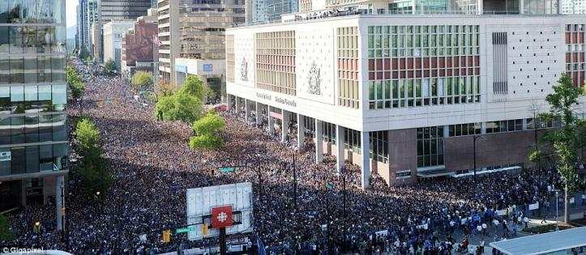
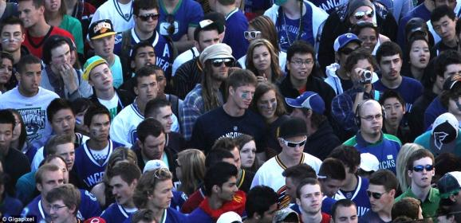

Slide 27
Solutions?
Ideally, optimize trade-offs by finding a balance
  I.e.: permit “good” usages of facial recognition,
  but avoid “creepy” usages
Problems:
  Define good, creepy
  Then, find out how to achieve that balance
Notes:
27

Slide 28
Solutions?
  Stop research on face recognition?
  Halt data collection?
  Regulate usage?
    Do-not-identify-me lists?
    Notice and consent? (I.e., transparency and control)
      Paradox of control (Brandimarte et al 2013)
      Limits of transparency (Adjerid et al 2013)
Notes:
28

Slide 29
Some key themes
Faces as conduits between online and offline data
Social network profiles as Real IDs
The emergence of PPI: “personally predictable” information
Democratization of surveillance
The rise of visual, facial searches
What will the future of privacy and anonymity be in a world with facial recognition and augmented reality?
Notes:
29

Slide 30


For More Information
Google/Bing: economics privacy
Visit: http://www.heinz.cmu.edu/~acquisti/economics-privacy.htm
Email: acquisti@andrew.cmu.edu
Notes:
30

