Slide 1
Privacy and Behavioral Economics:
From the Control Paradox
to Augmented Reality
Alessandro Acquisti
Heinz College
Carnegie Mellon University
LARC Workshop on User Privacy and Security, July 2011

Slide 2
What are the trade-offs associated with protecting and sharing personal data?
How rationally do we calculate, and make decisions about, those trade-offs?
What are the consequences of those decisions?
Can we (and should we) assist those decisions, through technology or policy design?
…

Slide 3
Background
From the economics of privacy…
  Protection and revelation of personal data flows involve tangible and intangible trade-offs for the data subject as well as the potential data holder
Notes:
3

Slide 4
Do data breach disclosure laws reduce identity theft?

Slide 5
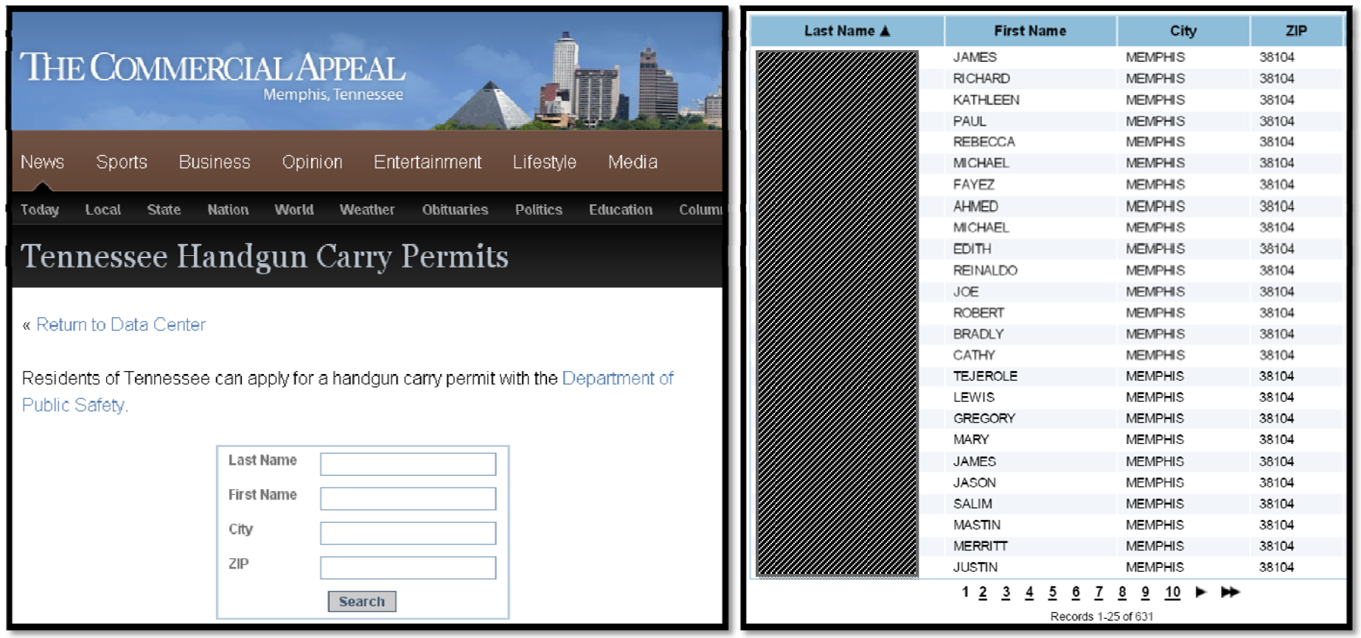
Guns, Privacy, and crime

Slide 6
Background
From the economics of privacy…
  Protection and revelation of personal data flows involve tangible and intangible trade-offs for the data subject as well as the potential data holder
… to the behavioral economics of privacy
  Incomplete information
  Bounded rationality
  Cognitive/behavioral biases
… to online social networks
Notes:
6

Slide 7
Background
From the economics of privacy…
  Protection and revelation of personal data flows involve tangible and intangible trade-offs for the data subject as well as the potential data holder
… to the behavioral economics of privacy
  Incomplete information
  Bounded rationality
  Cognitive/behavioral biases
… to online social networks
Notes:
7

Slide 8
Background
From the economics of privacy…
  Protection and revelation of personal data flows involve tangible and intangible trade-offs for the data subject as well as the potential data holder
… to the behavioral economics of privacy
  Incomplete information
  Bounded rationality
  Cognitive/behavioral biases
… to online social networks
Notes:
8

Slide 9
Our methodological approach
Controlled, randomized experiments (in the lab, in the field, survey-based, non survey-based, …)
Dependent variable(s) correlated with (heterogeneous, and otherwise latent and therefore unobservable) privacy concerns
  Actual behavior or Survey responses (self-disclosures)
  Validation studies or Comparative studies
Notes:
9

Slide 10
Three studies
  The inconsistency of privacy valuations
  About how the endowment effect affects people’s willingness to pay for privacy
  The paradox of control
  About the propensity to reveal personal information
  Discounting past information
  About the impact on others of one’s personal information
Joint works with Laura Brandimarte, Joachim Vosgerau, Leslie John, George Loewenstein

Slide 11
Three studies
  The inconsistency of privacy valuations
    With Leslie John and George Loewenstein
The paradox of control
Discounting past information

Slide 12
  The inconsistency of privacy valuations
Can mere framing change the valuation of personal data? Consider:
  Willingness to accept (WTA) money to give away information
vs.
  Willingness to pay (WTP) money to protect information
Hypothesis:
  People assign different values to their personal information depending on whether they are focusing on protecting it or revealing it
    Related to endowment effects studies (e.g., Thaler 1980)

Slide 13
Experimental design
Mall patrons asked to participate in (decoy) survey
As payment for participation, subjects were offered gift cards
We manipulated trade-offs between privacy protection and value of cards
Subjects endowed with either:
  $10 Anonymous gift card. “Your name will not be linked to the transactions completed with the card, and its usage will not be tracked by the researchers.”
  $12 Trackable gift card. “Your name will be linked to the transactions completed with the card, and its usage will be tracked by the researchers.”
Subjects asked whether they’d like to switch cards
  From $10 Anonymous to $12 Trackable (WTA)
  From $12 Trackable to $10 Anonymous (WTP)

Slide 14
WTP vs. WTA: Results
χ2(3) = 30.66, p < 0.0005

Slide 15
Implications
People’s concerns for privacy (and security) depend, in part, on priming and framing
Vicious circle: if you have less privacy, you value privacy less

Slide 16
Three studies
  The inconsistency of privacy valuations
The paradox of control
  With Laura Brandimarte and George Loewenstein
Discounting past information

Slide 17
Privacy and the paradox of control
Control :: Privacy
+

Slide 18
Privacy and the paradox of control
Control :: Privacy
=

Slide 19
Privacy and the paradox of control
Control :: Privacy
-

Slide 20
Conjecture
When deciding what to reveal about ourselves, we may confound
  1) control over publication of private information, and
  2) control over access/use of that information by others
… and end up giving more weight to the former over the latter
  Even though objective privacy costs derive from access to/use of information by others, not merely its publication

Slide 21
Two hypotheses
Subjects induced to perceive more control over publication of personal information, even though in reality they face the same (or even higher) objective risks associated with the access and use of that information, will disclose more sensitive information and/or more widely
Users induced to perceive less control over publication of personal information, even though in reality they do not face higher objective risks associated with the access and use of that information, will disclose less sensitive information and/or less widely
Why?
  Saliency (Slovic, 1975; Klein, 1998) of act of publishing
  Overconfidence
  See also Henslin 1967, Langer 1975

Slide 22
Three survey-based randomized experiments
Experiment 1: Reducing perceived control over publication of personal information
      Mediated vs. unmediated publication
Experiment 2: Reducing perceived control over publication of personal information
      Certainty vs. probability of publication
Experiment 3: Increasing perceived control over publication of personal information
      Explicit vs. implicit control

Slide 23
Three survey-based randomized experiments
Experiment 1: Reducing perceived control over publication of personal information
      Mediated vs. unmediated publication
Experiment 2: Reducing perceived control over publication of personal information
      Certainty vs. probability of publication
Experiment 3: Increasing perceived control over publication of personal information
      Explicit vs. implicit control

Slide 24
Experiment 3
Design
  Subjects: 100+ CMU students recruited on campus, March 2010
  Completed online survey
  Justification for the survey: study on ethical behaviors
  Ten Yes/No questions that focused on sensitive behaviors (e.g. drug use, stealing)
    Included demographics + privacy intrusive and non-intrusive questions (as rated by 49 subjects independently in a pre-study)
  DV: Answer/No answer

Slide 25
Experiment 3
Conditions (reduced)
  Implicit control condition (Condition 1)
  “All answers are voluntary. By answering a question, you agree to give the researchers permission to publish your answer.”
  Explicit control condition (Condition 3)
  “All answers are voluntary. In order to give the researchers permission to publish your answer to a question, you will be asked to check the corresponding box in the following page.”

Slide 26
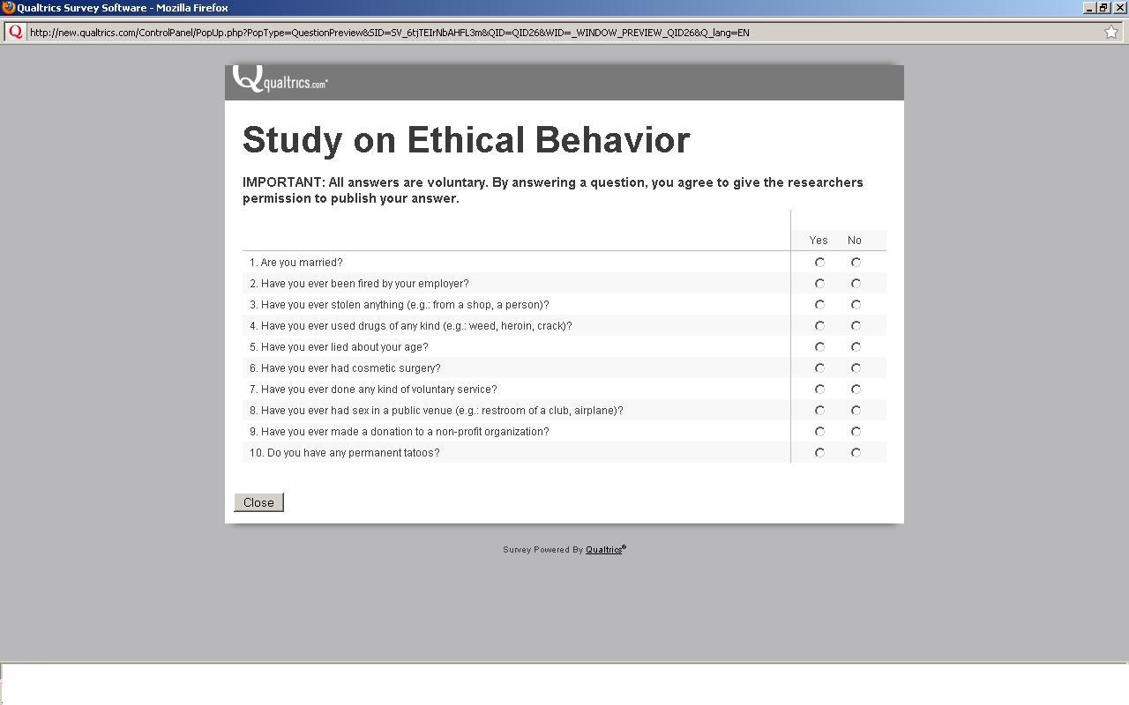
Implicit control condition

Slide 27
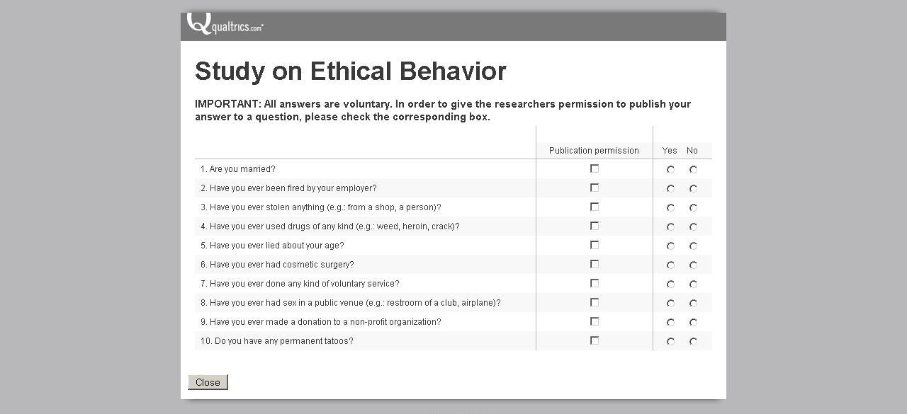
Explicit control condition

Slide 28
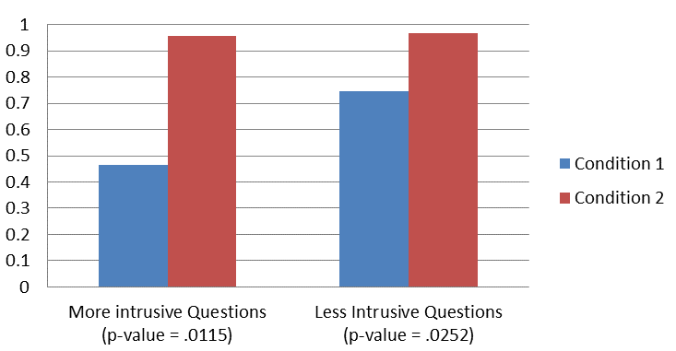
Results
Average Publication Rates

Slide 29
Results (DV: Published or not)
 | Coefficients and p-values
Treatment | 1.51** (.000)
Intrusive | -.85** (.000)
Treat_Int | 59* (.071)
Age | .01 (.753)
Male | -.10 (.653)
N Prob > χ² | 69 .000
RE Probit coefficients of panel regression of response rate on treatment with dummy for most intrusive questions, interaction and demographics
* indicates significance at 10% level; ** indicates significance at 5% level

Slide 30
Manipulation checks
Exit questionnaire focus on:
  Perceived control
  Privacy sensitivity
Mediation analysis based on exit questionnaire strongly supports our interpretation of the results:
  Higher perceived control decreases privacy concerns (and increases self-disclosure) even though actual accessibility by strangers to one’s personal information may increase

Slide 31
Implications
It is not just the publication of private information per se that disturbs people, but the fact that someone else will publish it for them
Results call into questions OSNs’ arguments of protecting privacy by providing more control to members
  Giving more control to users over information publication seems to generate higher willingness to disclose sensitive information

Slide 32
Three studies
  The inconsistency of privacy valuations
The paradox of control
Discounting past information
  With Laura Brandimarte and Joachim Vosgerau

Slide 33
Research question
The research question
Premise: Internet as the end of forgetting
How does information about a person or company’s past, retrieved today, get ‘discounted’?
  Specifically: does information about a person’s past with negative valence receive more weight in impression formation than information with positive valence?

Slide 34
Hypothesis
Hypothesis of differential discounting
Impact of information with negative valence lasts longer than impact of info with positive valence, not merely because of asymmetric effects of valence or memory effects, but also because of different weights (discount rates) applied to the two types of info
This may be due to
  Mobilization effects (Taylor 1991) and evolutionary theory (Baumeister et al. 2001)
  Negativity bias (Seligman & Maier 1967)
  Negative information is more attention grabbing (Pratto & John 1991)

Slide 35
Three survey-based randomized experiments
Testing our hypothesis: Three experiments
We ran three survey-based randomized experiments, manipulating valence of information about third parties provided to subjects and the time to which that information referred
Subjects were asked to express a judgment on the person or company they just read about
Three experiments:
  The dictator game
  The company experiment
  The wallet experiment

Slide 36
The wallet experiment
Experiment 2: The Wallet Story
Hypothetical scenario: subjects were presented background information about another person, and asked to express a judgment about her
  Baseline condition: only baseline information was provided
  Treatment conditions: manipulation of valence and time:
    We added to the baseline info one detail with either positive or negative valence
    And, we varied the time to which that detail referred

Slide 37
The story of Mr. A: Baseline condition
Here is some background information about Mr. A. Please review this information, and be ready to answer the questions below and in the next page.
Mr. A was born in San Diego, California, where he attended elementary and middle school. As a child, he obtained his social security number and received the standard DPT vaccination.
When he was 16 years old, he moved to Sacramento, California, with his family. He attended high school there and got his driving license.
After graduation he moved to Houston, Texas.

Slide 38
Treatment conditions
(positive/recent)
Here is some background information about Mr. A. Please review this information, and be ready to answer the questions below and in the next page.
Mr. A was born in San Diego, California, where he attended elementary and middle school. As a child, he obtained his social security number and received the standard DPT vaccination.
When he was 16 years old, he moved to Sacramento, California, with his family. He attended high school there and got his driving license.
Just about graduation, he found a lost woman's purse containing $10,000 in cash. He reported the discovery to the police, and the rightful owner retrieved her money.
After graduation he moved to Houston, Texas where he has been living and working for the past 12 months.

Slide 39
Treatment conditions
(negative/recent)
Here is some background information about Mr. A. Please review this information, and be ready to answer the questions below and in the next page.
Mr. A was born in San Diego, California, where he attended elementary and middle school. As a child, he obtained his social security number and received the standard DPT vaccination.
When he was 16 years old, he moved to Sacramento, California, with his family. He attended high school there and got his driving license.
Just about graduation, he found a lost woman's purse containing $10,000 in cash. He did not report the discovery to the police, and the rightful owner did not retrieve her money.
After graduation he moved to Houston, Texas where he has been living and working for the past 12 months.

Slide 40
Treatment conditions
(positive/old)
Here is some background information about Mr. A. Please review this information, and be ready to answer the questions below and in the next page.
Mr. A was born in San Diego, California, where he attended elementary and middle school. As a child, he obtained his social security number and received the standard DPT vaccination.
When he was 16 years old, he moved to Sacramento, California, with his family. He attended high school there and got his driving license.
Just about graduation, he found a lost woman's purse containing $10,000 in cash. He reported the discovery to the police, and the rightful owner retrieved her money.
After graduation he moved to Houston, Texas where he has been living and working for the past 5 years.

Slide 41
Treatment conditions
(negative/old)
Here is some background information about Mr. A. Please review this information, and be ready to answer the questions below and in the next page.
Mr. A was born in San Diego, California, where he attended elementary and middle school. As a child, he obtained his social security number and received the standard DPT vaccination.
When he was 16 years old, he moved to Sacramento, California, with his family. He attended high school there and got his driving license.
Just about graduation, he found a lost woman's purse containing $10,000 in cash. He did not report the discovery to the police, and the rightful owner did not retrieve her money.
After graduation he moved to Houston, Texas where he has been living and working for the past 5 years.

Slide 42
Dependent variables
Dependent variables:
  How much subjects liked the person described
  How much they trusted the person described
  How much they would like to work with her
    (Interpersonal Judgment Scale, Byrne 1961)

Slide 43
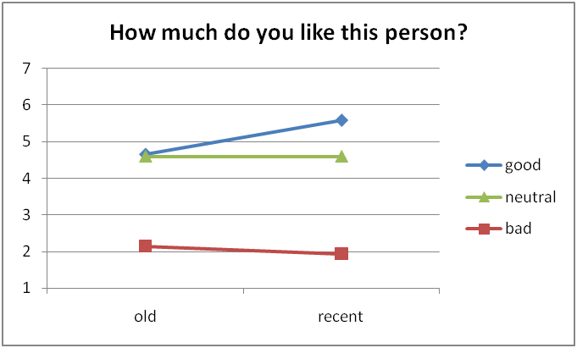
Results

Slide 44
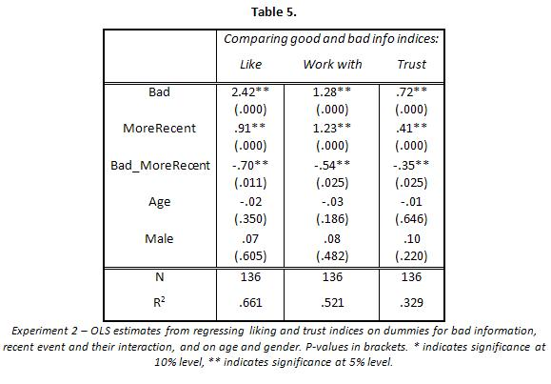
Results

Slide 45
Implications
Bad is not just stronger than good...
…. It is also discounted differently than good
Implications: future impact of information revealed today

Slide 46
Overall implications of these privacy studies
People’s concerns for privacy (and security) depend, in part, on priming and framing
  This does not necessarily mean that people don’t care for privacy, or are “irrational,” or make wrong decisions about privacy
Rather, it implies that reliance on “revealed preferences” argument for privacy may lead to sub-optimal outcomes if privacy valuations are inconsistent…
  People may make disclosure decisions that they stand to later regret
  Risks greatly magnified in online information revelation

Slide 47
The Future of personal information
In 2000, 100 billion photos were shot worldwide
In 2010, 2.5 billion photos per month were uploaded by Facebook users alone
In 1997, the best face recognizer in FERET program scored error rate of 0.54 (false reject rate at false accept rate of 1 in 1000)
In 2006, the best recognizer scored 0.01 (almost two order of magnitudes better)
An augmented reality world: Your face is the link between your online and offline data
Notes:
47

Slide 48
Experiment 1
Re-identifying a dating site profiles using Facebook images
We re-identified about 15% of members of a popular online dating site
Notes:
48

Slide 49

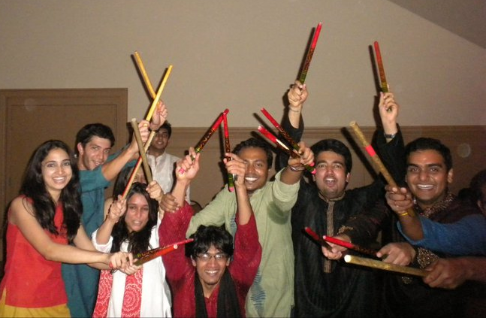
Experiment 2
Re-identifying students on CMU Campus using Facebook profiles
CMU campus
Facebook
Notes:
49

Slide 50
Experiment 2: Results
Combined total over two experiment days:
106 subjects
Unclustered matches:
  Correctly recognized: 32 (30%)
Clustered matches
  Correctly recognized: 45 (42%)
Notes:
50

Slide 51
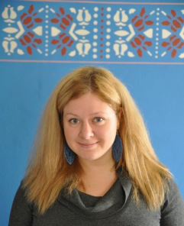
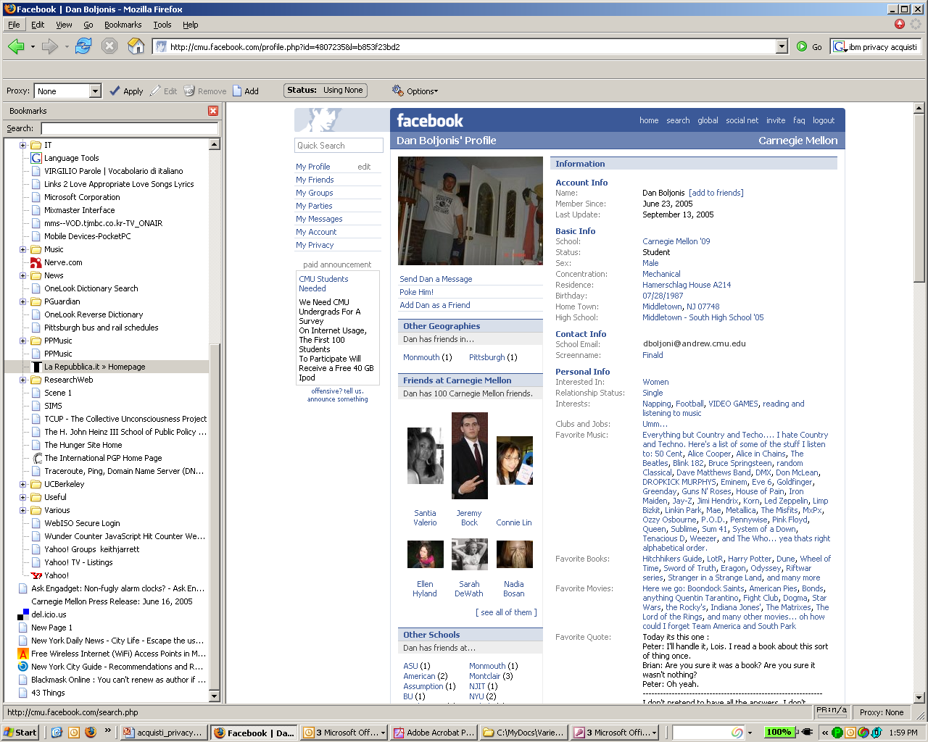

What we have shown so far
+
=
Notes:
51

Slide 52
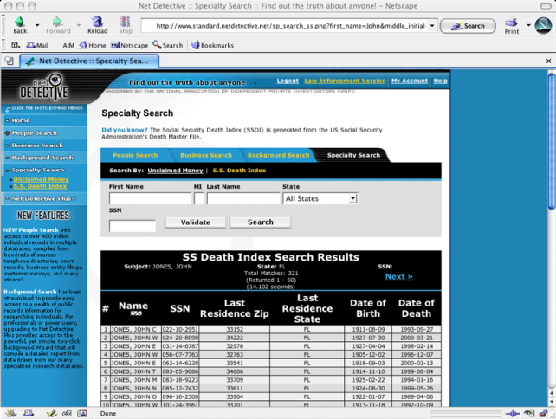
What we had done before
(Acquisti and Gross 2009)
+
= SSN
Notes:
52

Slide 53
Can you do 1+1?
+
= SSN
I.e., predicting your SSN from your face
Notes:
53

Slide 54
Behavioral experiments suggest that “choice & notification” approach to privacy protection is not working
Facebook profiles are (de facto) becoming (unregulated) Real IDs
Biggest future privacy threats may come from augmented reality apps
What will control mean in an augmented reality world?
What will privacy mean in an augmented reality world?
Notes:
54

Slide 55
For more info
Google: economics privacy
Visit: http://www.heinz.cmu.edu/~acquisti/economics-privacy.htm
Email: acquisti@andrew.cmu.edu
Notes:
55

